Slide 1
NAIHC Updates: September 17, 2024
N A I HC Legislative and Program Aide – Blythe McWhirter

Slide 2

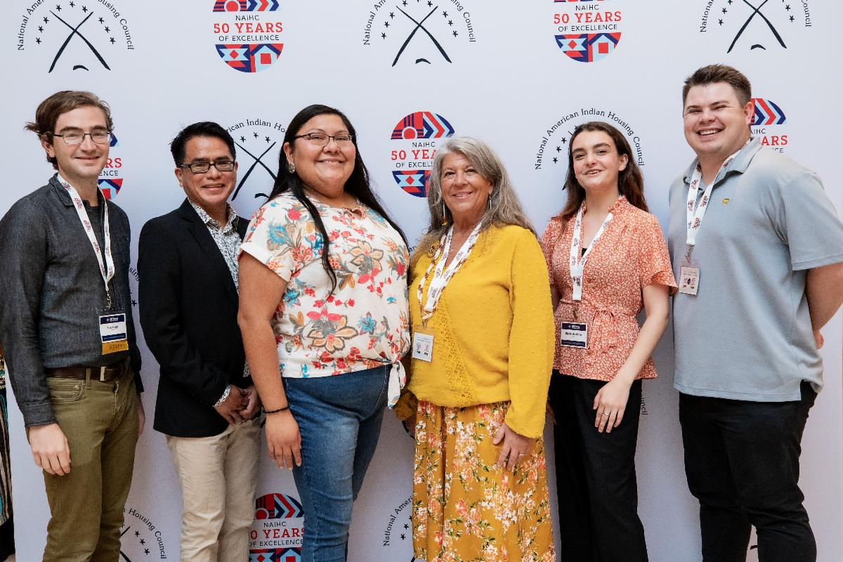




Who We Are
NAIHC is a 501(C)(3) non-profit organization
50th Anniversary (est. 1974)
Main services:
Advocacy
Training & Technical Assistance
Membership Support
Mission Statement
“To effectively and efficiently promote and support American Indians, Alaska Natives, and Native Hawaiians in their self-determined goal to provide culturally relevant and quality affordable housing for Native people.”
Annual Events

Slide 3
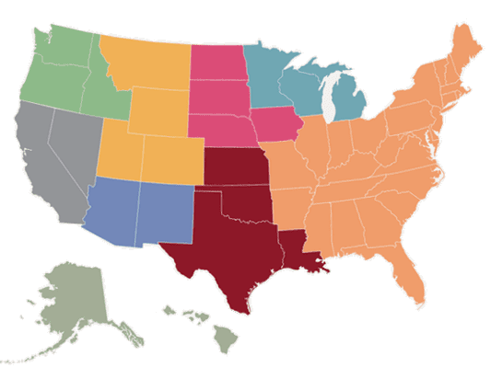
Membership
Board Chair : Bobby Yandell Housing Authority of the Choctaw Nation
Region I Board Member | Vacant
Region II Board Member | Char Roberts Red Lake Reservation Housing Authority
Region III Board Member | Sharon Vogel Cheyenne River Housing Authority
Region IV Board Member | Kelly Cook Chickasaw Nation Division of Housing
Region V Board Member | Jody Perez Salish & Kootenai Housing Authority
Region VI Board Member and Vice Chair | Sami Jo Difuntorum Siletz Tribal Housing Department
Region VII Board Member | Thomas Lozano Enterprise Rancheria
Region VIII Board Member | Jamie Navenma Laguna Housing Development and Management Enterprise
Region IX Board Member | Jackie Pata Tlingit-Haida Regional Housing Authority
NAIHC is a membership organization with 262 members, representing more than 450 Tribes and TDHEs across Indian Country.
The interests of NAIHC’s members are represented through nine regional Board members, nine regional Board alternates, and a Board chair.
VI
II
III
V
VII
I
VIII
IV
IX

Slide 4
2023 IHBG Competitive Awardees (SWTHA)
White Mountain Apache Housing Authority
San Ildefonso Housing Authority
Santa Clara Housing Authority
Zuni Housing Authority
TOTALING
$16,500,000 in IHBG Competitive Grant funding
Construction of 53 new housing units

Slide 5
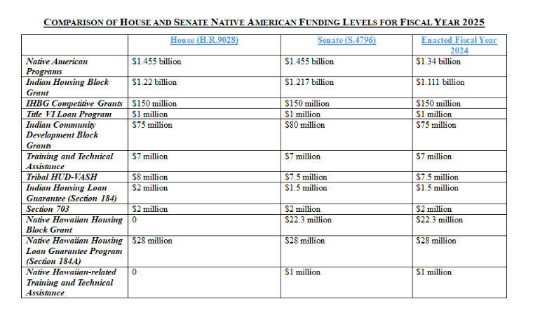
Advocacy Updates
FY2025 NAHASDA Program Funding Levels
←
NAHASDA reauthorization is attached as an amendment to the 2025 NDAA.
NAIHC/NCAI inter-org support letter
Program Updates:
      THUD-VASH
      Section 184
      Environmental Reviews
      College Student Rental Assistance
      IHS Sanitation Services
(Comparison chart c/o Powers Law)

Slide 6
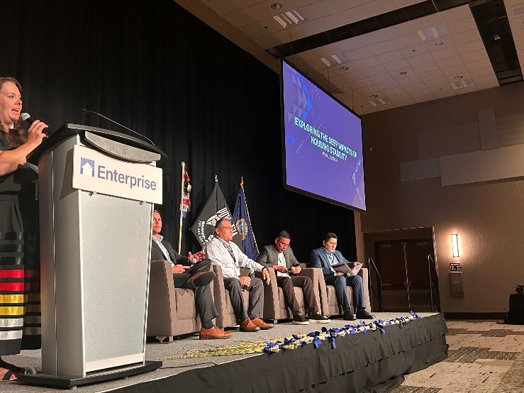
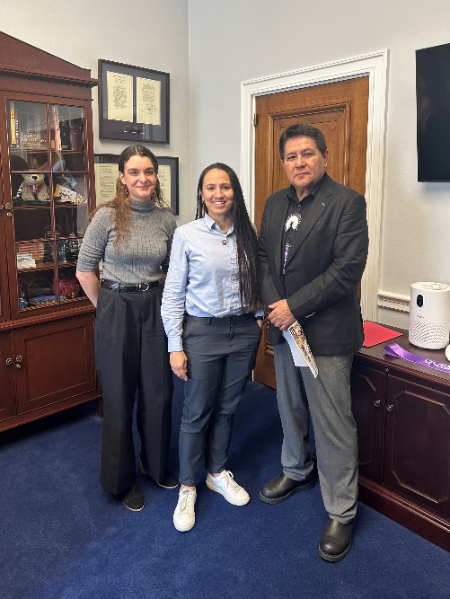
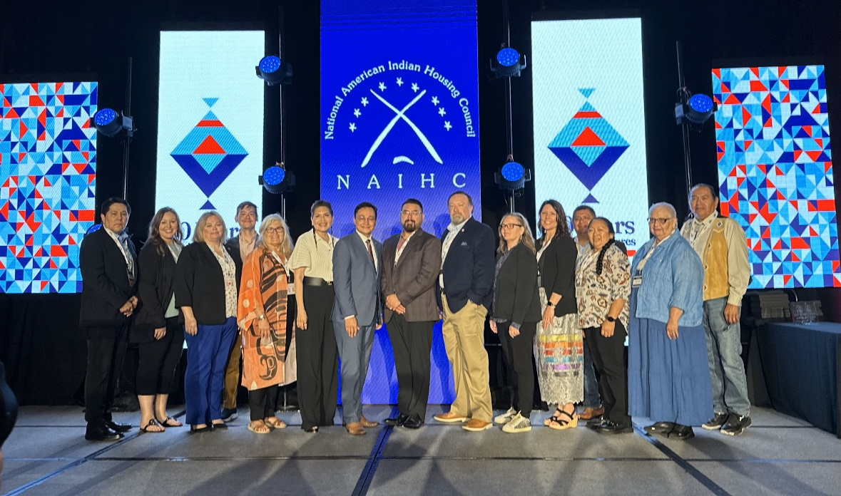
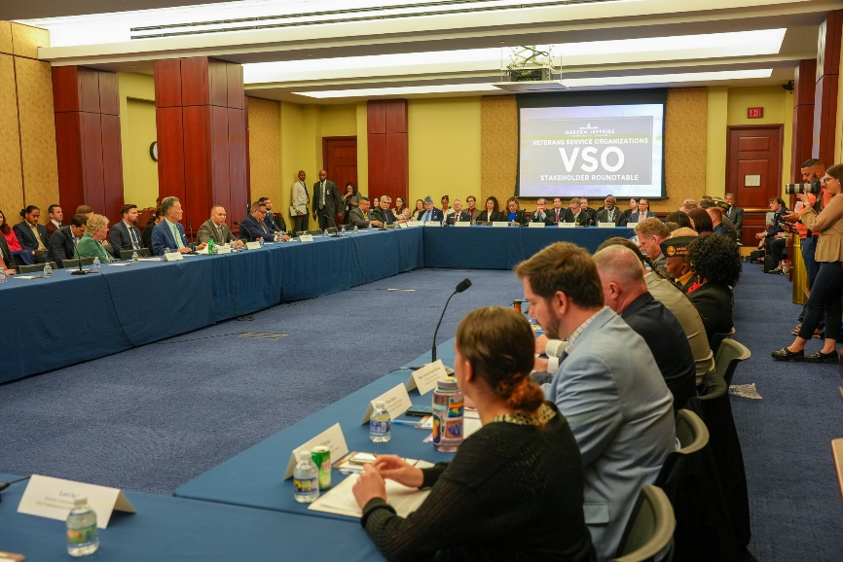
Advocacy Cont’d

Slide 7
Training and Technical Assistance
Streamlining Training and Technical Aspects
Includes sourcing venues and hotels, creating budgets on time, event planning, and conducting post-training follow-ups.
Performance and Training Evaluations
This is a crucial step in ensuring that our training programs are effective and meet the needs of the participants.
Training and Technical Assistance Department (T&TA)
Recording Project
Re-starting the recording project.
This project will greatly enhance our training materials and provide a valuable resource for our trainees
Simplifying Internal Processes
This initiative is aimed at enhancing efficiency and reducing the time taken to complete various tasks.
Daily Operations
Handling all the daily operations as needed. This includes managing schedules, coordinating with team members, and ensuring all tasks are timely.
Processing Overdue Training Certificates
We understand the importance of these certificates for our trainees and are working diligently to ensure they are issued promptly

Slide 8

NAIHC 2024 Legal Symposium
Save the Date!
NAIHC Legal Symposium
When: December 9-12, 2024
Where: MGM Grand Las Vegas
Registration now open!
Each year, NAIHC’s Legal Symposium brings together over 500 tribal housing professionals, tribal leaders, law firms serving Indian country, tribal administrative and compliance staff, and federal officials from HUD, USDA, BIA, EPA, and other agencies.
Past Legal Symposium attendees also include paralegals, occupancy specialists handling leases/evictions, risk management professionals, law school academics, legal scholars, in-house attorneys at housing authorities and tribal legal department staff. Together, Symposium participants share ideas, experiences, and best practices as well as address emerging issues.

Slide 9
Thank You

