Slide 1

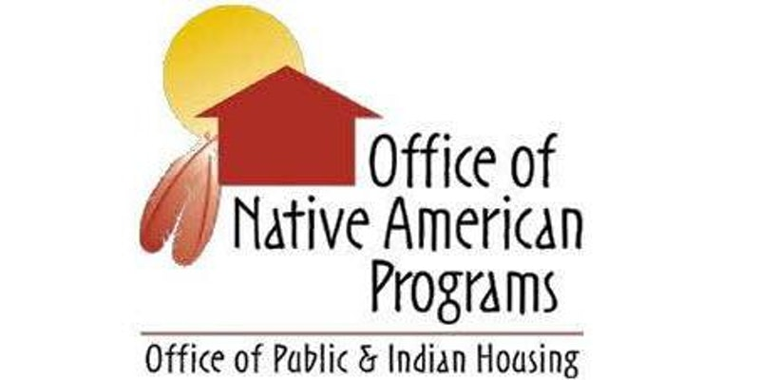

Southwest Office of Native American Programs

Slide 2
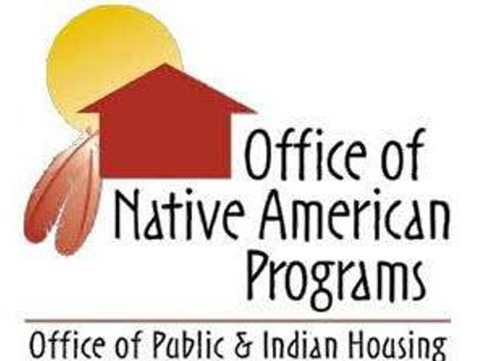
Southwest Office of Native American Programs
U.S. Department of Housing and Urban Development Southwest Office of Native American Programs
Dr. Corinna Stiles, Administrator (602) 379-7235
Floyd Tortalita, Deputy Administrator (505) 346-6924
Phoenix Office Albuquerque Office
2800 North Central Ave-Suite 700 500 Gold Ave, SW, 7th Floor, Ste 7301
Phoenix, AZ 85004 P.O. Box 906
(602) 379-7100 Albuquerque, NM 87103-0906
(505) 346-6923

Slide 3
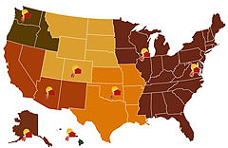
ONAP HQ and Area Offices
Headquarters Staff
6 Area Offices
  Alaska
  Eastern Woodlands (Chicago)
  Southern Plains (Oklahoma City)
  Southwest (Phoenix and Albuquerque)
  Northern Plains (Denver)
  Northwest (Seattle)
  Hawaii (Honolulu)

Slide 4
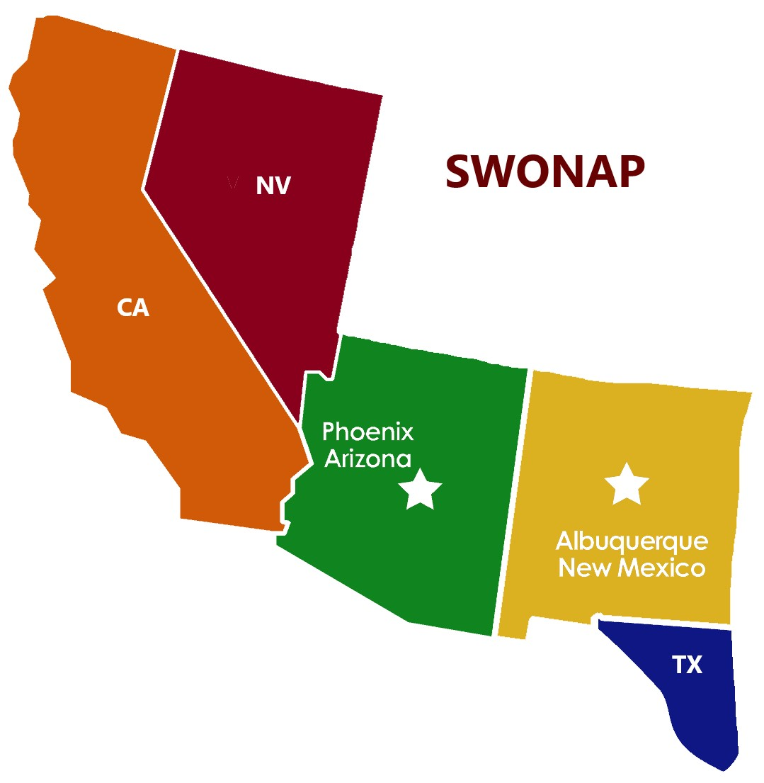
Southwest Office of Native American Programs
The Office of Native American Programs (ONAP) administers programs designed to support affordable housing and community development activities for Native Americans, Alaska Natives, and Native Hawaiians.
Service Area: Arizona, California, Nevada, New Mexico & Ysleta del Sur (TX)

Slide 5
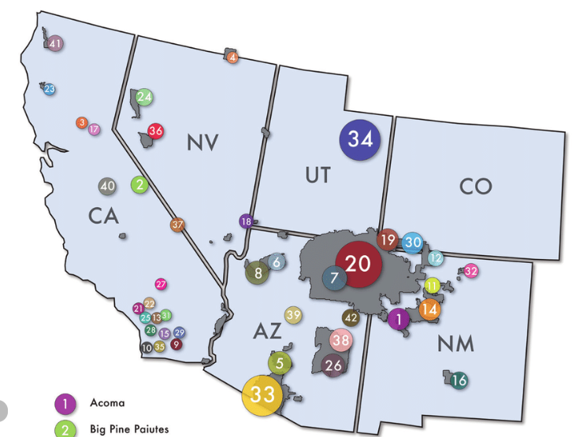
SWONAP Grantees
Approximately over 157 active tribal grantees – Tribes & TDHEs
California – 109 Tribes/Rancherias/
Colonies
Arizona – 22 Tribes
New Mexico
Nevada – 19 Tribes
New Mexico – 23 Pueblos/Tribes

Slide 6
SWONAP Staff (33 in Phoenix and Albuquerque)
Administrator
Deputy Administrator
Grants Management Directors (2)
Grants Evaluation Directors (2)
Grants Management Team Leads (4)
Native American Program Specialist
Administrator Advisor
Grants Management Specialists (9)
Grants Evaluation Team Leads (4)
Grants Evaluation Specialists (8)

Slide 7
SWONAP Divisions
Administration
Grants Management
Grants Evaluation
Administration
Directs Area Office programs and staff
Fosters effective and efficient collaboration with HQ, other Federal agencies, Indian Housing Associations, Congressional Delegates, and other partners
Grants Management
Manage day-to-day relationships with Tribes/TDHEs
Oversee grant award and administration including review of grant applications & LOCCS draws
Provide technical guidance
  Grants Evaluation
    Responsible for program monitoring and grant compliance
    Review financial audits and reports
    Provide technical guidance

Slide 8
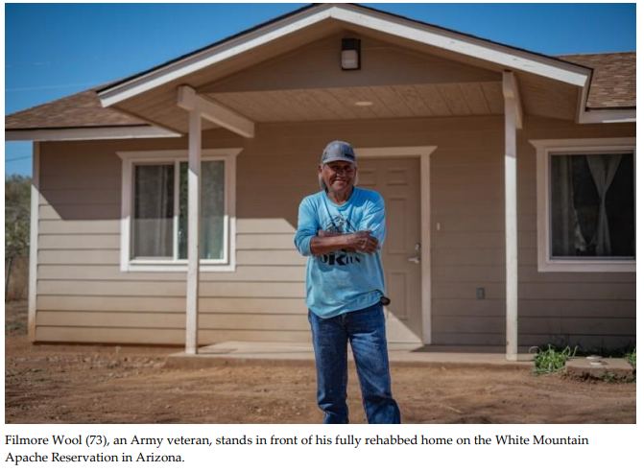
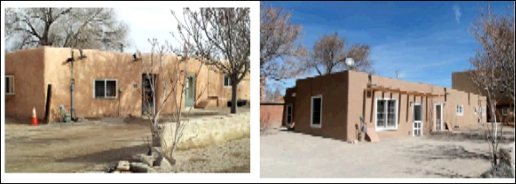
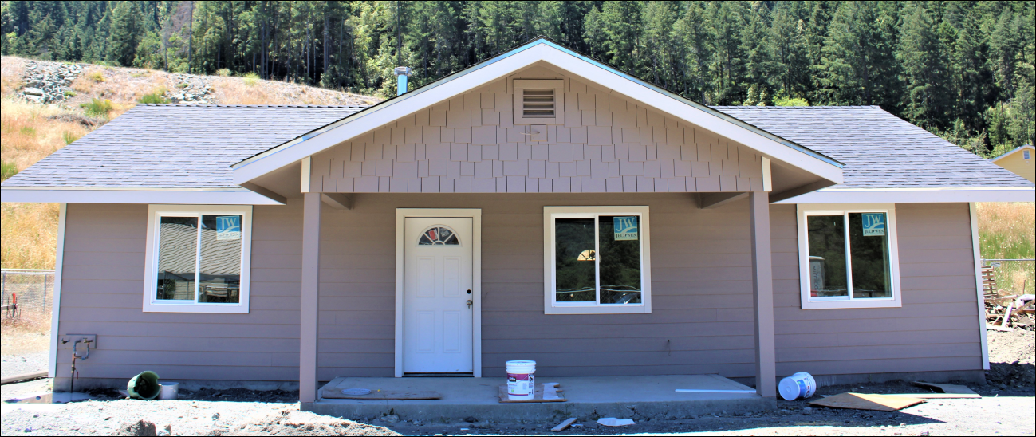
Project Examples
Ohkay Owingeh Housing Authority
Hoopa Valley Housing Authority
Veteran in front of his home – White Mountain Apache HA

Slide 9
Southwest Office of Native American Programs
2024 Budget Appropriations for Native American Programs
$1.34 billion in funding allocated as follows:
$1.1 billion for formula Indian Housing Block Grants (IHBG) - $324 million (41%) more than the 2023 Appropriations Act. $368.5 million SWONAP. $260 million SWTHA members
$150 million for IHBG competitive grants;
$ 75 million for Indian Community Development Block Grants;
$ 1 million for Title VI, and
$ 7 million for Technical Assistance and Training, includes a $2 million set-aside for NAHASDA technical assistance.
$ 22.3 million for Native Hawaiian Housing Block Grants.

Slide 10
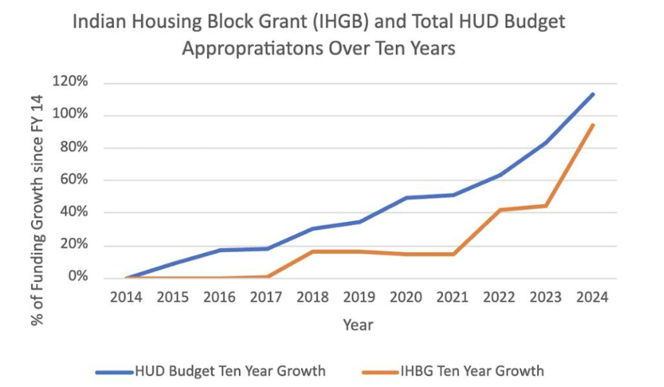
IHBG Appropriations Growth
2014-2024
The ‘minibus’ appropriations package, the Consolidated Appropriations Act of 2024, provided $1.34 billion for Native American Programs, a $324 million increase (32%) above the FY23 enacted. This includes $1.11 billion for the Indian Housing Block Grant (IHBG), formula, a $324 million (41%) increase above FY23 enacted.

Slide 11
ONAP Overview
As sovereign nations, Tribes are direct recipients of funding from HUD.
Each Tribe designates an entity to administer its housing programs.
* Tribally Designated Housing Entity
* Department within Tribe
* Tribal Housing Authority with separate board
* Non-profit organization
An Entity designated by a Tribe to receive HUD funding must comply with all program requirements.

Slide 12
ONAP Programs
Indian Housing Block Grant Program
Indian Housing Block Grant Competitive Program
Indian Community Development Block Grant
Indian Home Loan Guarantee Program (Section 184)
Title VI Loan Guarantee Program
Native Hawaiian Housing Block Grant Program
Native Hawaiian Home Loan Guarantee Program (Section 184A)
Tribal HUD-VASH Program
Other
CARES ACT
American Rescue Plan
ROSS
Notes:
Heidi mentioned that we operate as a mini HUD –
14 Different Programs
Primary Programs IHBG largest program
We have grown into additional programs
- Competitive IHBG, Tribal HUD VASH, ROSS, and other are continuing to be developed through COC and ICDBG

Slide 13
ONAP Funding Programs
Indian Housing Block Grant (IHBG) - Formula-based grant program. Grant funds must be used to primarily benefit low-income Indian families. Eligible activities include housing development, housing assistance, housing services, crime prevention and safety, and model activities. Tribes determine how to spend their funding (as long as they are carrying out eligible activities). Recipient submits an Indian Housing Plan at the beginning of their Program Year and an Annual Performance Report after the Program Year’s conclusion.
IHBG Competitive - During FY 2022, HUD awarded $94 million in competitive IHBG funds from the FY 2021 appropriations to 24 Tribal communities.
Indian Community Development Block Grant (ICDBG) - Competitive awards providing single purpose grants for housing rehabilitation, land acquisition, community facilities, infrastructure construction, and economic development activities that benefit primarily for low - moderate income persons.

Slide 14
ONAP Loan Guarantee Programs
Loan Guarantee Programs – Authorized under NAHASDA
Section 184 Indian Home Loan Guarantee Program - Created in 1992 to help increase Native access to homeownership. Provides guarantee to lenders on mortgage loans made to Native borrowers. Section 184 loans can be used, both on and off native lands, and for new construction, rehabilitation, purchase of an existing home, or refinance.
Title VI Loan Guarantee Program - HUD guarantees 95% of outstanding principal & interest on a loan made by a private lender to an IHBG recipient for IHBG eligible activities. Tribal/TDHE Borrowers pledge a portion of their current and future IHBG funds as security for the repayment of the federally guaranteed financial obligation. Historically, the primary use of Title VI loans has been the construction of housing units and related infrastructure.
Since program inception in 1996, HUD has issued a total of 117 Title VI loan guarantees, totaling more than $290 million. This has resulted in the development, rehabilitation, or installation of infrastructure for approximately 3,560 affordable housing units. During FY 2022, four Title VI loans were guaranteed for $17,520,711.

Slide 15
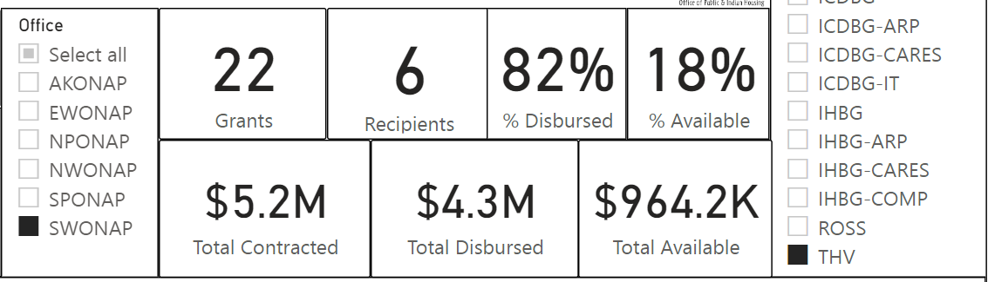
Tribal HUD-VA Supportive Housing Program (Tribal HUD-VASH)
Program Inception 2015 - HUD and VA jointly launched a demonstration program.
Program offers a permanent home and supportive services to Native American Veterans who are experiencing or at risk of homelessness.
Tribal HUD-VASH provides rental assistance and supportive services to Native American veterans living on or near a reservation or other Indian areas.
Indian tribes and TDHEs participating in this program must partner with VA to provide case management and supportive services to eligible Native American veterans.

Slide 16
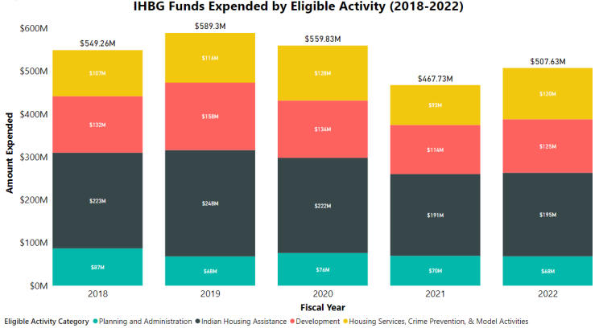
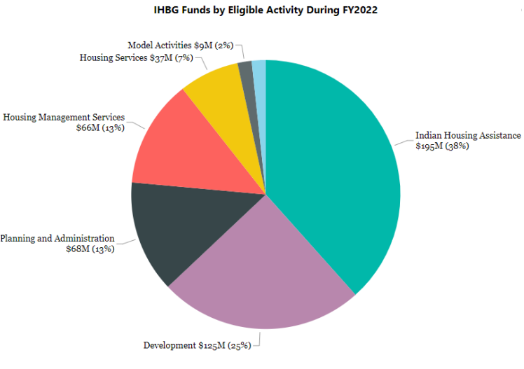
FY2018-2022 IHBG Funding by Eligible Activity
Indian Housing Assistance ($195MM/38%)
Development ($125MM/25%)
Housing Management Services ($66MM/13%)
Planning & Administration ($68MM/14%)
Housing Services ($36MM/7%)
Crime Prevention & Model Activities ($17MM/3%)

Slide 17
Southwest Office of Native American Programs
2023 Indian Community Development Block Grant
- 38 Tribal Communities Awarded
    Alaska 6 awards $ 9,281,730
    Eastern Woodlands 3 awards $ 5,291,133
    Northern Plains 6 awards $ 10,681,888
    Northwest 2 awards $ 3,573,597
    Southern Plains 9 awards $ 17,280,061
    Southwest 12 awards $ 23,674,076
TOTAL $ 69,782,485

Slide 18
ONAP Technical Assistance & Training
ONAP offers FREE Technical Assistance and Training
ONAP partners with expert technical assistance providers knowledgeable about Indian Housing topics such as:
Tribal Housing Board Roles & Responsibilities
Addressing Housing and Community Safety Needs
Managing Housing Programs
Program Income
Procurement & Contract Administration
Financial Management & Reporting
Self-Monitoring
Admissions & Occupancy, and
NAHASDA Essentials
Notes:
FY 2022 Training Highlights • Over 2,600 individuals received specialized, focused training and technical assistance.
• ONAP and its expert TA providers delivered 220 direct technical assistance training sessions.
ONAP planned and facilitated training events focused on identified issues and needs in Indian Country.
A total of 105 trainings were held (either in-person or virtually), which is an increase from the 69 trainings in 2021.

Slide 19
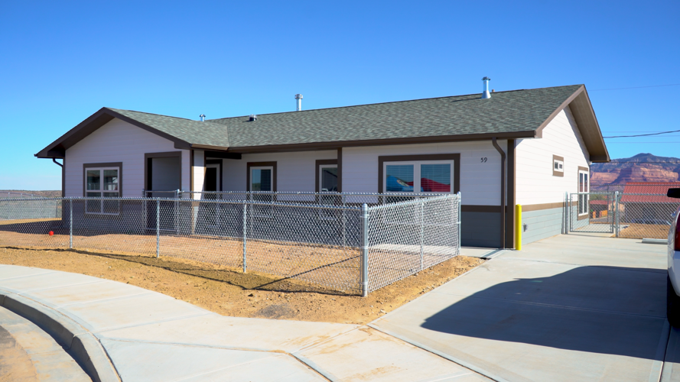
ONAP Mission and
Program Highlights
Tribal Partnerships & Initiatives
Choice Neighborhoods Planning Grants
Build America, Buy America Act (BABA)
Continuum of Care Tribal Homelessness Network
DOI Tribal Domestic Water Supply Projects
DOE & HHS Clean Energy Connector
Inflation Reduction Act (IRA) – clean energy
FCC ConnectHome – Internet for All
ONAP Programs positively impact Indian Country by:
Increasing Supply of safe, decent & affordable housing for Native Americans
Providing fair and ample credit opportunities for Native American homebuyers; and
Supporting healthier economies and better employment opportunities
Notes:
The IRA provides more than $720 million to support Tribal communities as they transition to renewable energy and become more climate resilient. This includes rebates for high-efficiency electric homes; loans for developing clean energy projects such as solar and wind; financial and technical assistance in renewable energy; and pollution reduction grants.
Tribal lands account for more than 6% of the country’s renewable energy potential, according to the National Renewable Energy Laboratory. But a lot of promise remains untapped – 21% of homes in Navajo Nation and 35% of Hopi Indian Tribe homes lack electricity.

Slide 20
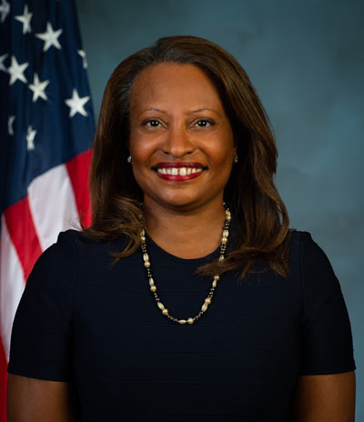
HUD Leadership
Adrianne Todman is Acting Secretary of the U.S. Department of Housing and Urban Development (HUD).
Heidi J. Frechette serves as HUD’s Deputy Assistant Secretary for Native American Programs, managing a budget of more than $700 million and a team of approximately 140 professional employees in Washington, DC, and seven other offices across the nation.

Slide 21
Southwest Office of Native American Programs
Thank You. . .
Dr. Corinna Stiles, Administrator
(602) 379-7235
Floyd Tortalita,
Deputy Administrator
(505) 346-6924

