Slide 1
NAIHC Updates: May 14, 2024
N A I HC Executive Director – Douglas Marconi Sr.

Slide 2
Road Map
Welcome to NAIHC’s Newest Staff
Who We Are
Regional NAIHC Representatives
Legislative Updates
Advocacy
50th Anniversary Tradeshow and Convention

Slide 3


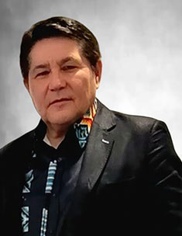
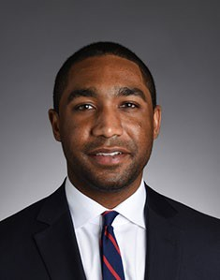
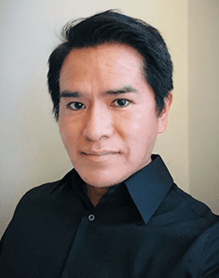
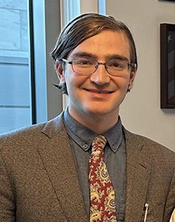
Welcome to NAIHC’s Newest Staff!
Blythe McWhirter
Brendon Spann
Legislative and Program Aide
Membership Coordinator
Douglas Marconi Sr.
Ezra Kruger
Lavar Curley
Executive Director
Office Administrator
Training and Technical Assistance Coordinator
Currently Hiring:
Director of Operations

Slide 4
Who We Are
Board Chair : Thomas Lozano Enterprise Rancheria
Region I Board Member | Vacant
Region II Board Member | Char Roberts Red Lake Reservation Housing Authority
Region III Board Member | Sharon Vogel Cheyenne River Housing Authority
Region IV Board Member | Bobby Yandell Housing Authority of the Choctaw Nation
Region V Board Member | Jody Perez Salish & Kootenai Housing Authority
Region VI Board Member and Vice Chair | Sami Jo Difuntorum Siletz Tribal Housing Department
Region VII Board Member | Vacant
Region VIII Board Member | Jamie Navenma Laguna Housing Development and Management Enterprise
Region IX Board Member | Chris Kolerok Cook Inlet Housing Authority
NAIHC is a 501(C)(3) non-profit organization
50th Anniversary (est. 1974)
Supports tribes and TDHEs in their efforts to provide safe, decent, affordable, and culturally appropriate housing for Native Communities
NAIHC is a membership organization with over 440 members representing about 475 tribes and tribal housing organizations.

Slide 5
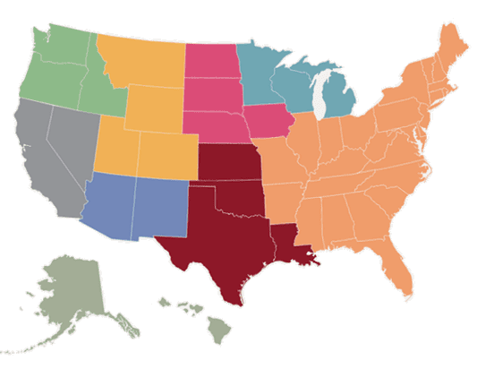
Regional NAIHC Representatives (Region VIII)
Region VIII (Arizona, New Mexico, West Texas)
Board Member
Jamie Navenma
Executive Director of the Laguna Housing Development and Management Enterprise
Phone: (505) 552-9409
E-mail: jamien@lagunahousing.org
VI
III
II
V
VII
I
VIII
IV
Board Alternate
Greta Armijo
Executive Director of the Pueblo of Jemez Housing Authority
Phone: (575) 834-0305
E-mail: great.armijo@pojha.org
IX

Slide 6
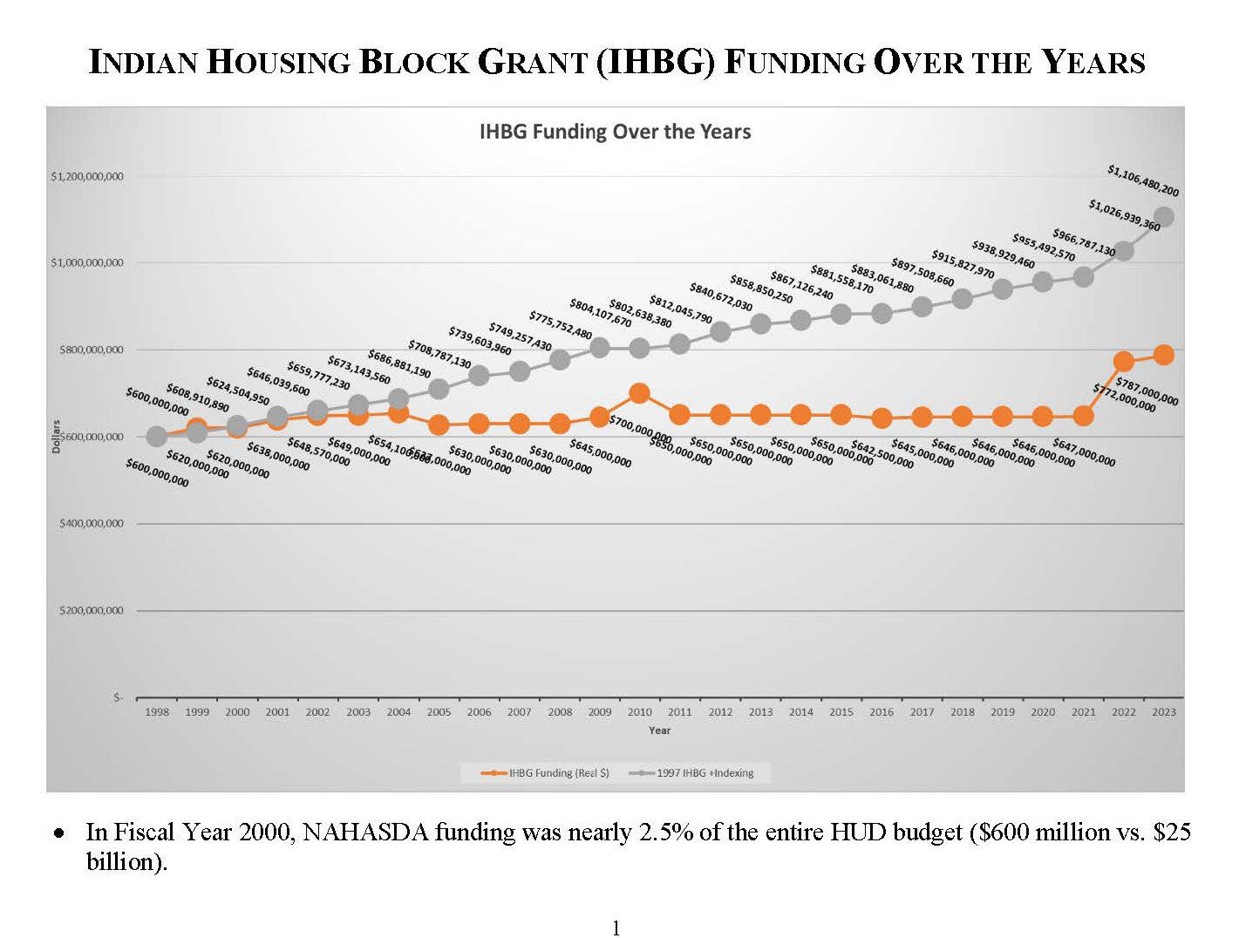
Legislative Updates
THUD FY24 Appropriations Bill
$1.344b for Native American Programs
~32% increase from FY2023
$1.11b for IHBG
White House FY25 Budget Request
                $1.053b for Native American Programs
                ~20.6% decrease from FY2024
                $820m for IHBG
NAIHC is preparing to request a 4% increase in IHBG funding over the $1.11b appropriated for 2024. This request aims to keep pace with the program’s original purchasing power.

Slide 7
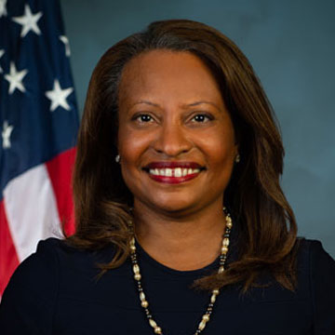
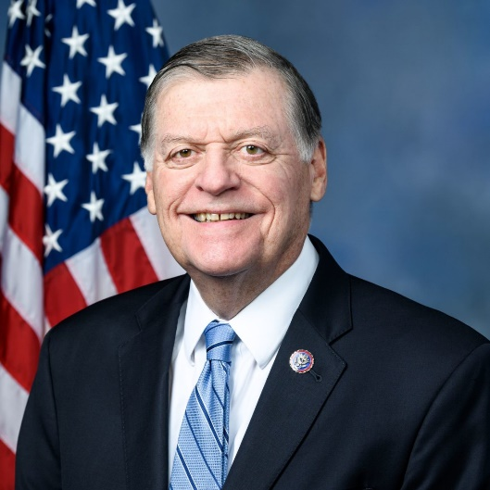
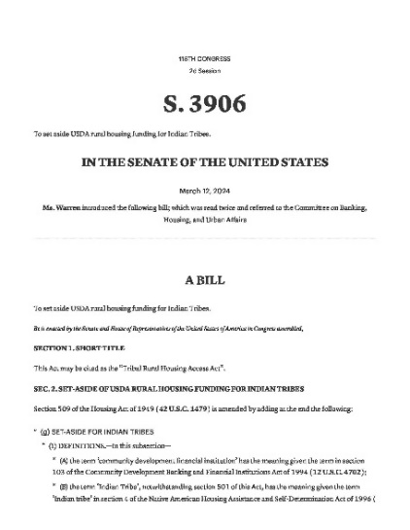
Legislative Updates Cont’d
Deputy Sec. Adrianne Todman now Acting Secretary of HUD
Assumed role following Marcia Fudge’s departure March 22nd.
Tom Cole (R-OK) secures Chair of Appropriations Committee
Cole’s prestigious appointment comes after 15 years on the Committee and 22 years in Congress.
Tribal Rural Housing Access Act (S.3906)
Directs USDA to set aside 5% of certain RHS funds for Tribal Nations, TDHEs, and Native CDFIs

Slide 8
Advocacy
NAIHC Board of Directors Delivers Letter to HUD Requesting Waiver for Build America, Buy America
  Letter addressed to HUD Secretary and ONAP Deputy Assistant Secretary Heidi Frechette
  Opportunity for comment deadline has been extended to June 17, 2024
  Resolution to be introduced at NAIC’s Mid-Year Conference in June
NAHASDA Reauthorization
  Future strategy and S.B. 2285
Making HUD-VASH a Permanent Program
  H.R. 4155 – Introduced by Congressman Tom Cole
  Evaluating the efficiency of the current system, coordinating best practices for distributing vouchers to Native veterans through the formation of an ad hoc subcommittee of the Legislative Committee

Slide 9
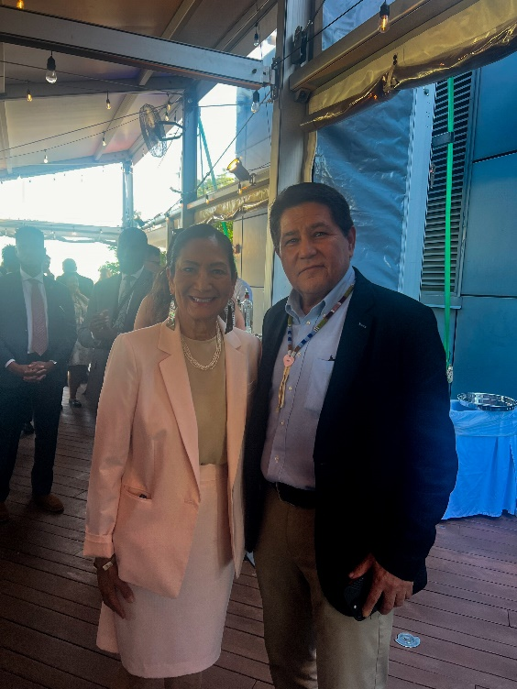
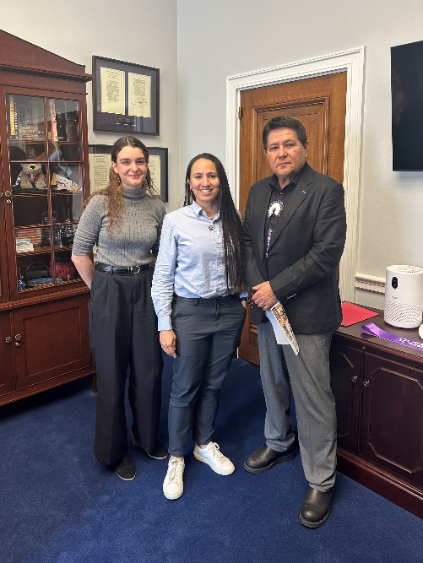
Advocacy Cont’d
Final Rule on Section 184
  Identifying strategies to further improve Section 184 Loan Program, organizing an advisory group of loan experts
  Opportunity for comment on Section 184 open until May 31st
Meetings with Congressmembers
  Scheduling meetings with Congressmembers, consulting with Congress staffers on FY25 funding levels
Secretary of the Interior, Deb Haaland
Congresswoman Sharice Davids (D-KS)

Slide 10


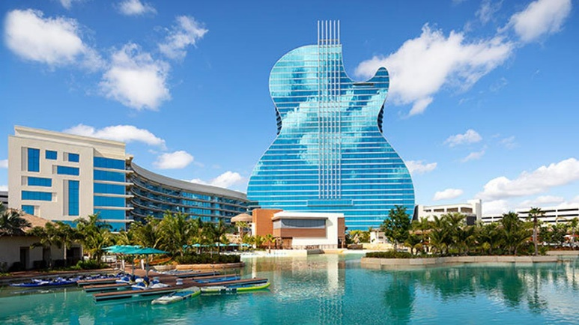
50th Annual Convention and Tradeshow
The National American Indian Housing Council (NAIHC) is excited to announce the 2024 Annual Convention and Tradeshow at the Seminole Hard Rock Hotel and Casino on June 24-27, 2024, in Hollywood, Florida.
NAIHC appreciates the Seminole Tribe's warm welcome, and we are honored to have the opportunity to share Native housing opportunities at NAIHC's 50th Annual Convention & Tradeshow.
This year's theme is, "50 Years of Building Futures". NAIHC is expecting over 700 tribal leaders and housing professionals.
This year's convention will feature remarks from keynote speakers and panel discussions highlighting tribal housing programs. Attendees will have over 70 breakout sessions on Innovations in Housing, Construction Cost Impact, Preparing Citizens for Homeownership Success, and Aligning Housing with Community Needs.

Slide 11
Thank You

