Slide 1
Communicating with Tribal Leadership
Southwest Tribal Housing Association (SWTHA) Training
Jeremiah powless enterprise community partners
January 2024

Slide 2
Tribal Nations Team
Enterprise Community Partners
Tonya Plummer Director
tplummer@enterprisecommunity.org
Morgan Dean Program Director
mdean@enterprisecommunity.org
Jeremiah Powless Program Officer
jpowless@enterprisecommunity.org
Evelyn Immonen Program Officer
eimmonen@enterprisecommunity.org

Slide 3
How Tribal Leaders Can Support Homeownership
Module 11

Slide 4
Who are Tribal Leaders
Tribal Officials (Elected or Appointed)
Tribal/Traditional Elders
Influencers – Individuals with special social capital
Hierarchy of administration – city code & planning
TDHE – other Tribal orgs
Community advisors & committees

Slide 5
Bringing Solutions

Slide 6
Making the Case

Slide 8
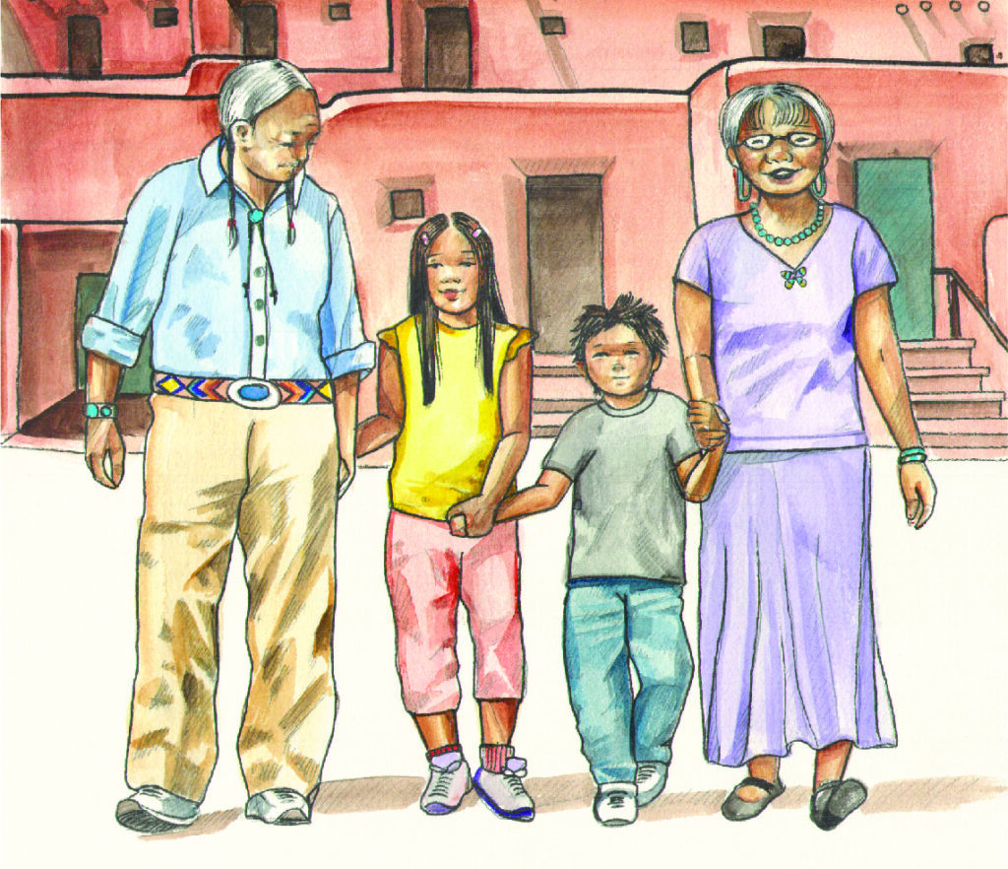
Why… Household Stability/Homeownership
Household stability
Increased community buy-in
Predictive costs for the future
Social-emotional/improvements in health outcomes
Living costs similar, equity GROWS

Slide 9
Growing Tribal Economies

Slide 10
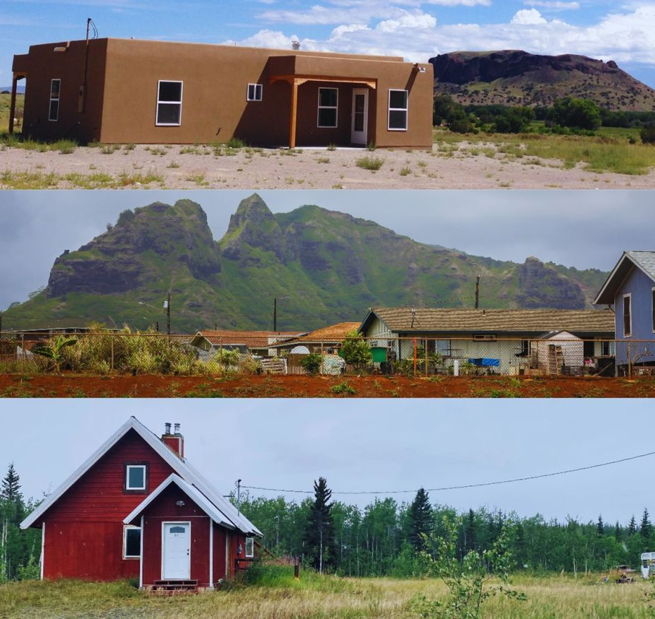
Tribal Housing Stock
Housing Stock
Balance between availability in rentals vs. Private owned
Addressing the full spectrum of housing needs in your community

Slide 11
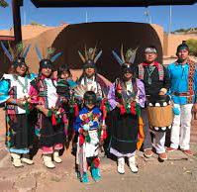
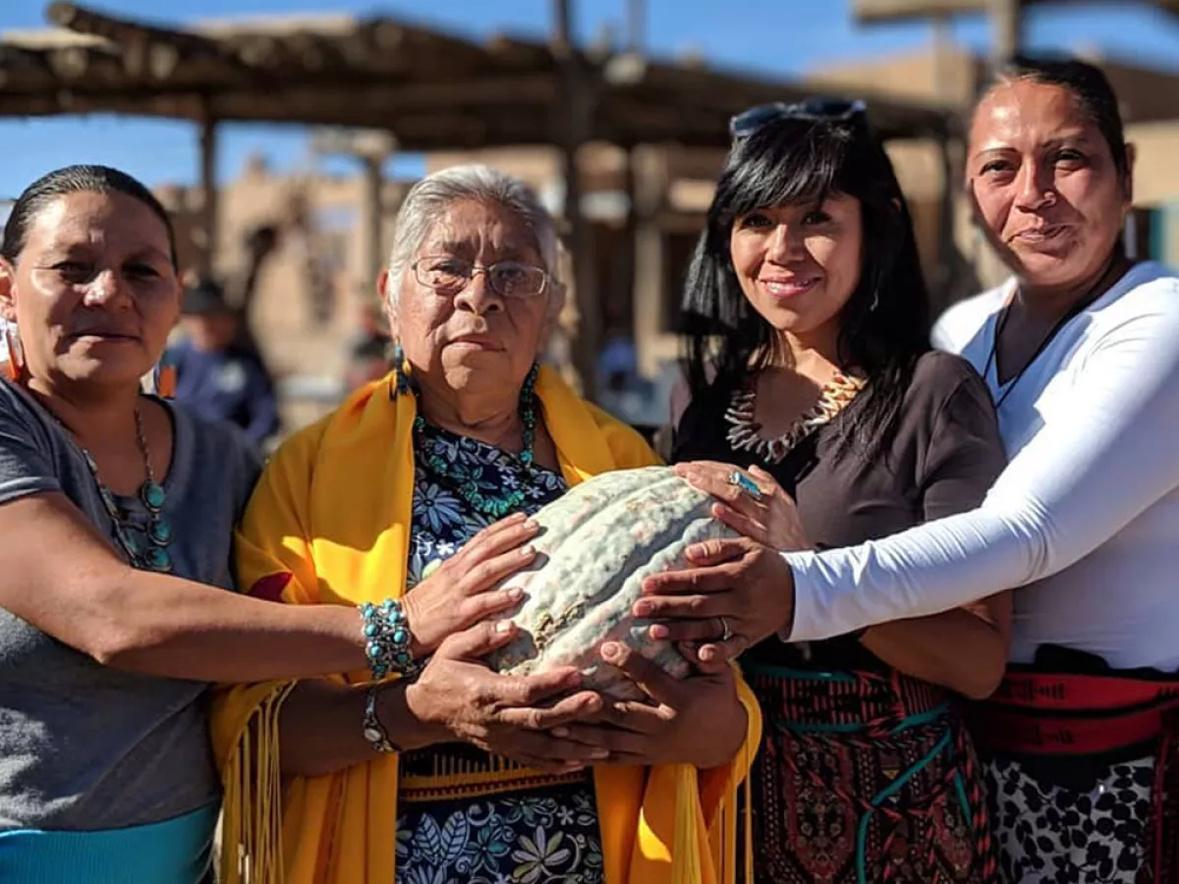
Culture Preservation

Slide 12
Making the Case

Slide 13
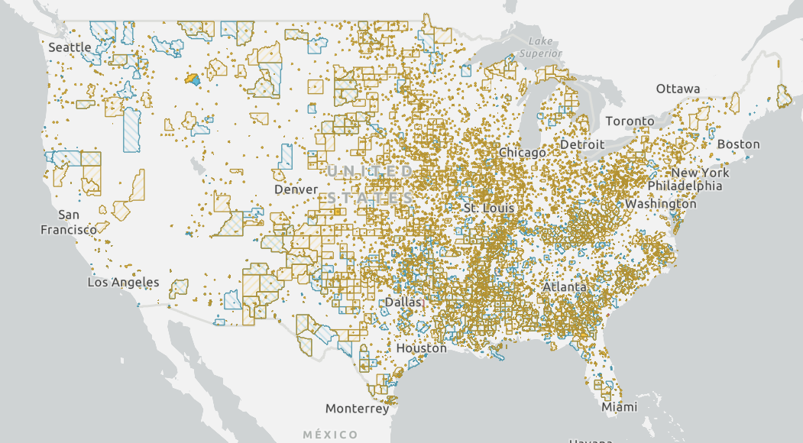
ARPA and DCTA
Showing support
Distressed Cities and Persistent Poverty Technical Assistance (DCTA): https://www.hudexchange.info/programs/dcta/
Including, but not limited to, changing market dynamics, economic decline, emigration, and/or natural disasters.
Eligibility map
Benefits to participating in the DCTA:
Improve financial management
Improve internal processes
Build program capacity
American Rescue Plan Act (ARPA) of 2021: Link to info page
If you have not already spent these dollars, don't send them back! Request Technical Assistance from HUD to figure out how to spend these funds.

Slide 14
Navigating Risk Management – Identifying Potential Concerns

Slide 15
WORKSHEET ACTIVITY
Tribal Leader and Housing Authority Meeting Role Play – Asking for something…
Worksheet:
1.) Let's Get Clear - What are we asking Tribal Leaders to Do
2.) Make Your Case - Why this matters - What problem it solves
3.) Anticipate Conflict - Navigating Risk Management

Slide 16
REFLECTIONS

Slide 17
Asking for Help…

Slide 18
Together wE Achieve More

Slide 19
Tribal Nations Team
Enterprise Community Partners
Tonya Plummer Director
tplummer@enterprisecommunity.org
Morgan Dean Program Director
mdean@enterprisecommunity.org
Jeremiah Powless Program Officer
jpowless@enterprisecommunity.org
Evelyn Immonen Program Officer
eimmonen@enterprisecommunity.org

Slide 20
Thank You

