Slide 1
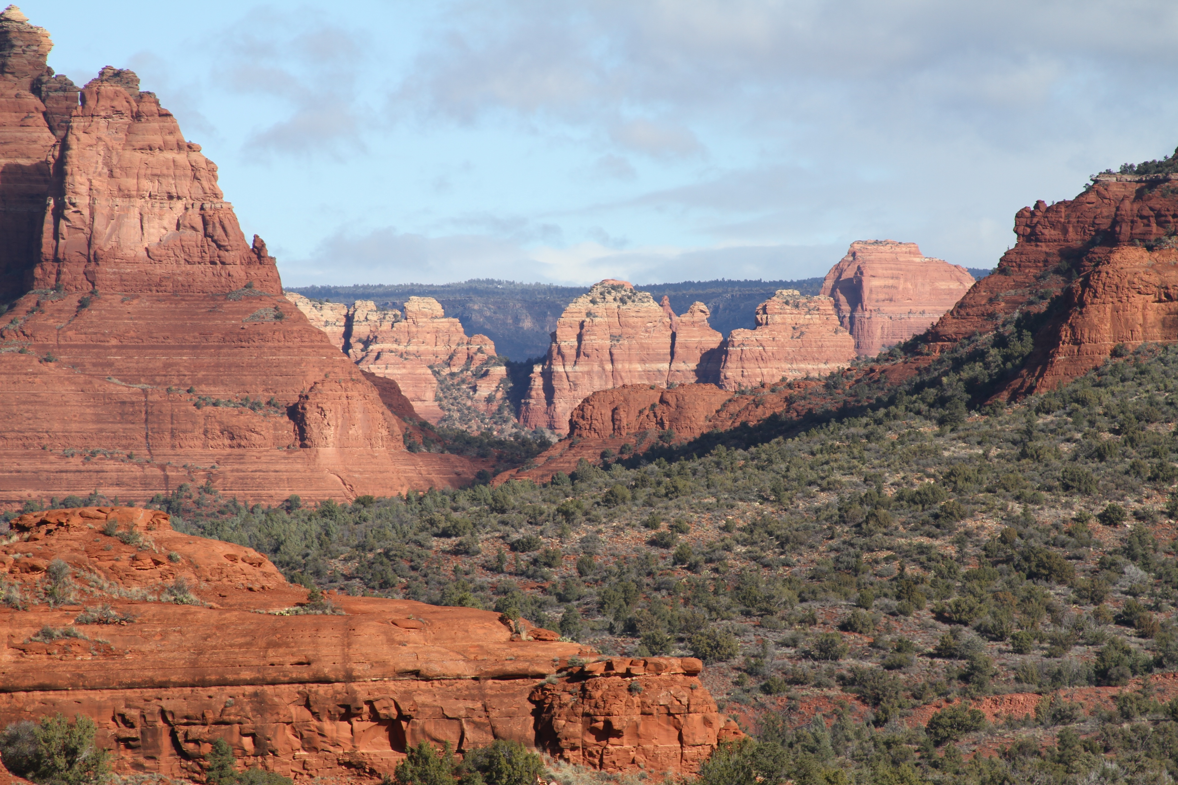
Southwest Office of Native American Programs (SWONAP) Update SWTHA Meeting May 8, 2023
Jody Moses Administrator

Slide 2
Announcements
2022 ICDBG Awards-Expect awards to be announced in May 2023
2023 IHBG Competitive-NOFO likely to be published in May 2023
April 24, 2023-Revised Maximum Loan Limits for the Section 184 Indian Home Loan Guarantee Program and
Section 184A Native Hawaiian Home Loan Guarantee Program. https://www.hud.gov/sites/dfiles/PIH/documents/DLL_2023- 03_Attachment_A184_Loan_Limits.pdf
Notice of Proposed Rulemaking: Floodplain Management and Protection of Wetlands; Minimum Property Standards for Flood Hazard Exposure; Building to the Federal Flood Risk Management Standard
HUD is excited to announce the publication of the Notice of Proposed Rulemaking (NPRM) for our proposed rule Floodplain Management and Protection of Wetlands; Minimum Property Standards for Flood Hazard Exposure; Building to the Federal Flood Risk Management Standard, and the associated opening of the public comment period through May 24, 2023. With this NPRM, HUD takes a major step in addressing future flood risk and ensuring the safety of HUD-assisted residents and federal investments.
The proposed rule implements the Federal Flood Risk Management Standard (FFRMS). The FFRMS addresses requirements of both Executive Order (EO) 13690, Establishing a Federal Flood Risk Management Standard and a Process for Further Soliciting and Considering Stakeholder Input and EO 14030, Climate-Related Financial Risk.
NAHASDA emphasizes the government-to-government relationship between the Federal Government and Tribes and recognizes that Tribes should make policy decisions and manage programs for their members and their communities.

Slide 3
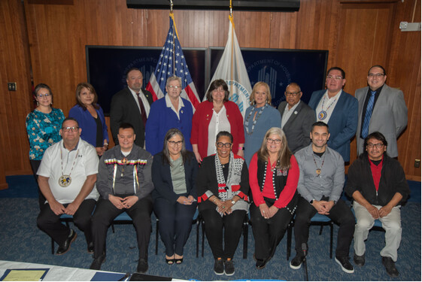
Secretary Marcia L. Fudge Convenes First-Ever U.S. Department of Housing and Urban Development (HUD) Tribal Intergovernmental Advisory Committee Meeting
WASHINGTON - U.S. Department of Housing and Urban Development (HUD) Secretary Marcia L. Fudge hosted HUD’s first-ever Tribal Intergovernmental Advisory Committee (TIAC) meeting at the Robert C. Weaver Federal Building. The two-day convening included Tribal leaders from across the continental United States and Alaska that make up the HUD Tribal Intergovernmental Advisory Committee. The meeting focused on Nation-to-Nation relationships with Tribal governments, Tribal Sovereignty, housing needs and challenges in Indian Country, and funding for Tribal housing and community development programs.
15 members of TIAC

Slide 4
TIAC Members
Gary Batton, Chief, Choctaw Nation of Oklahoma, Durant, Oklahoma.
Darren Brinegar, Tribal Legislator, Ho-Chunk Nation, Black River Falls, Wisconsin.
Glenn Ellis, Jr., Council Member, Makah Indian Tribe, Neah Bay, Washington.
Tina Glory-Jordan, Secretary of State, Cherokee Nation, Tahlequah, Oklahoma (at-large).
Denise Harvey, Council Member, Confederated Tribes of Grand Ronde, Grand Ronde, Oregon.
Victoria Hobbs, Legislative Council Representative, Tohono O’odham Nation, Sells, Arizona.
Patricia MacDonald, Council President, Healy Lake Village, Fairbanks, Alaska.
Jacqueline Pata, 1st Vice President, Central Council of Tlingit and Haida Indian Tribes of Alaska, Juneau, Alaska
Marshall Pierite, Chairman, Tunica-Biloxi Tribe of Louisiana, Marksville, Louisiana.
Bridgett Sorenson, Board of Director, Sault Ste. Marie Tribe of Chippewa Indians, Kincheloe, Michigan.
Lee Spoonhunter, Council Member, Northern Arapaho Tribe of Wyoming, Fort Washakie, Wyoming.
Arch Super, Council Member, Karuk Tribe, Happy Camp, California
Scott Herman, Chairman, Rosebud Sioux Tribe, Rosebud, South Dakota
Teri Nutter, Elected Official, Gulkana Village, Gakona, Alaska
Tyler Yellow Boy, Council Member, Oglala Sioux Tribe, Oglala, South Dakota

Slide 5
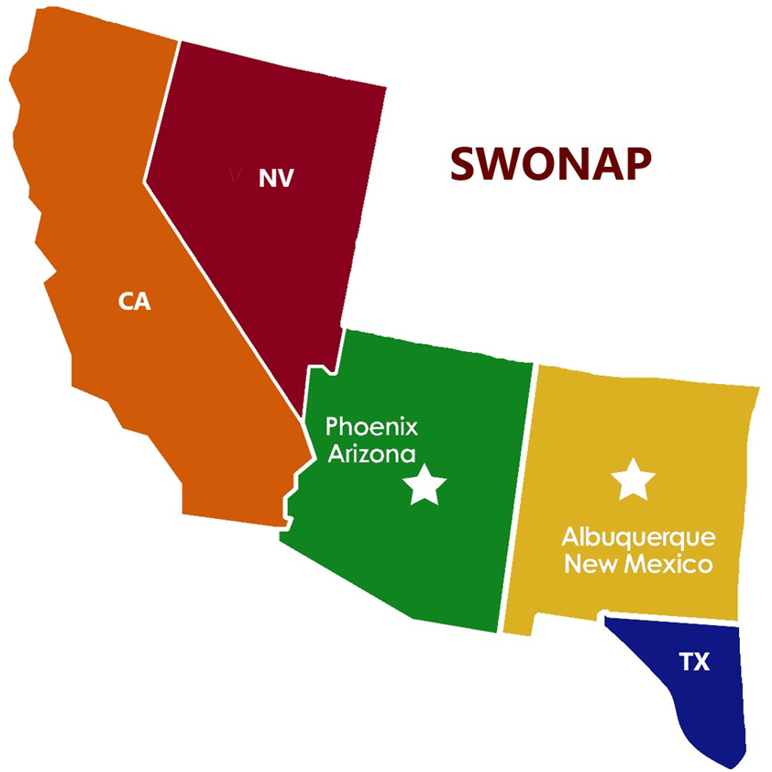
Funding Across the Southwest
2023 IHBG Formula
NV 20 Awards totaling $16,725,132
CA 101 Awards totaling $56,012,819
AZ 20 grants totaling $136,932,920
NM 20 Awards totaling $17,063,425
2021 ICDBG
NV 0 awards
CA 7 Awards totaling$4,991,566
AZ 1 grant totaling $2,000,000
NM 4 awards totaling $3,200,000.00
2022 IHBG Competitive
NV 0 awards
CA 8 grants totaling $28,390,458
AZ 0 grants
NM Two Grants totaling $10,000,000.
IHBG ARP
NV $ 10,125,763
CA $29,925,487
AZ $88,160,470
NM $10,437,270
IHBG CARES
NV $4,579,612
CA $13,784,821
AZ $37,019,923
NM $4,842,703

Slide 7
Training & Technical Assistance
May 16-18-Strategic Planning Training
May 23-25-Intermediate Financial Management
May 23-25-Admissions & Occupancy
June 6-8-Housing Policy Workshop
June 13-14-Needs Assessment & Community Engagement
Reach out to your SWONAP Grants Management Specialists for TA requests
Full schedule of trainings can be found on HUDCODETALK.gov

Slide 8
SWONAP is HIRING! Leadership Position
Supervisory Evaluation Specialists, GS-14,(GE Director)
Go to USAJOBS USAJOBS - The Federal Government's official employment site to learn more about the position and apply
Supervisory Grants Evaluation Specialist, GS-14
Location: Albuquerque, NM
Open: April 26, 2023 Close: May 10, 2023

Slide 9
SWONAP Contacts
Jody A. Moses, Administrator Jody.A.Moses@hud.gov
VISIT OUR WEBSITES:
Codetalk:
https://www.hud.gov/program_offices/public_indian_housing/ih SWONAP:
https://www.hud.gov/program_offices/public_indian_housing/ih/codetalk/onap/swonap
SECTION 184:
https://www.hud.gov/program_offices/public_indian_housing/ih/homeownership/184 TITLE VI:
https://portal.hud.gov/hudportal/HUD?src=/program_offices/public_indian_housing/ih/homeownership/titlevi
COVID-19 Recovery Programs:
https://www.hud.gov/program_offices/public_indian_housing/ih/Covid_Recovery

Slide 10
SWONAP Appreciates Your Partnership! ENJOY HAWAII! Thank you!
This Photo by Unknown Author is licensed under CC BY-NC-ND

