Slide 1
NAIHC Legislative Committee
We will begin at 1:03 Eastern
Tony Walters
Executive Director

Slide 2
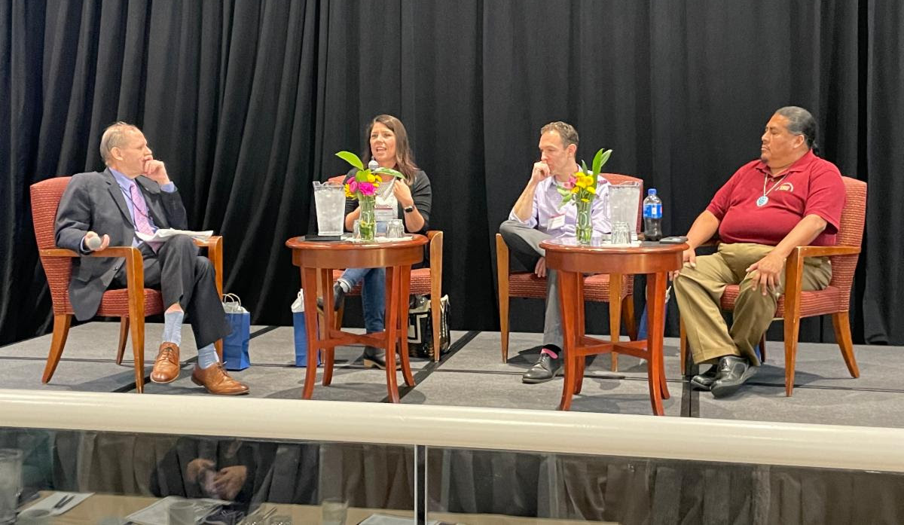
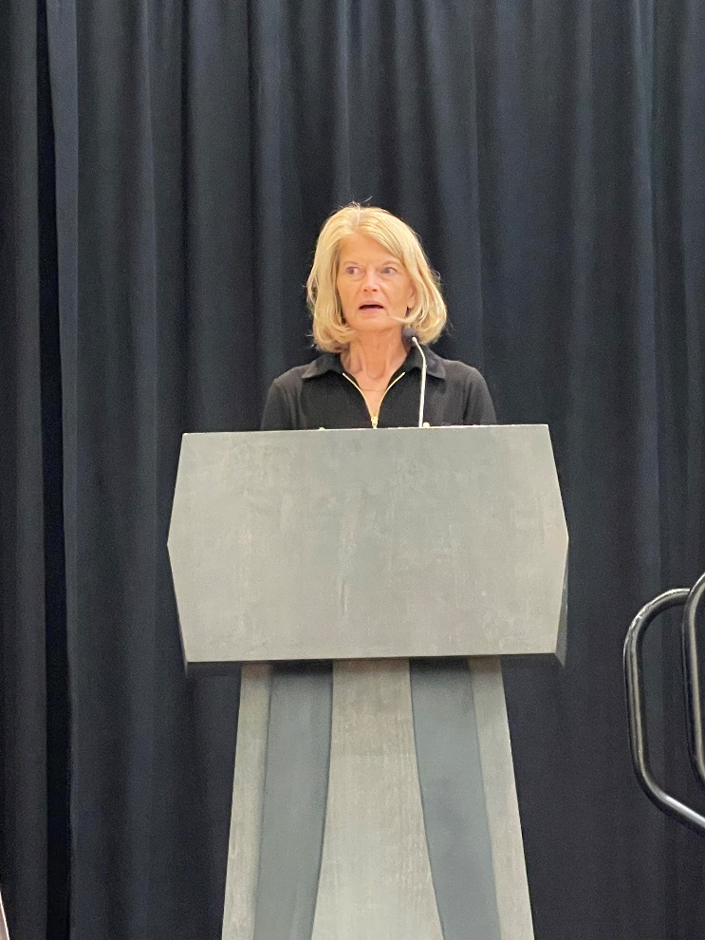
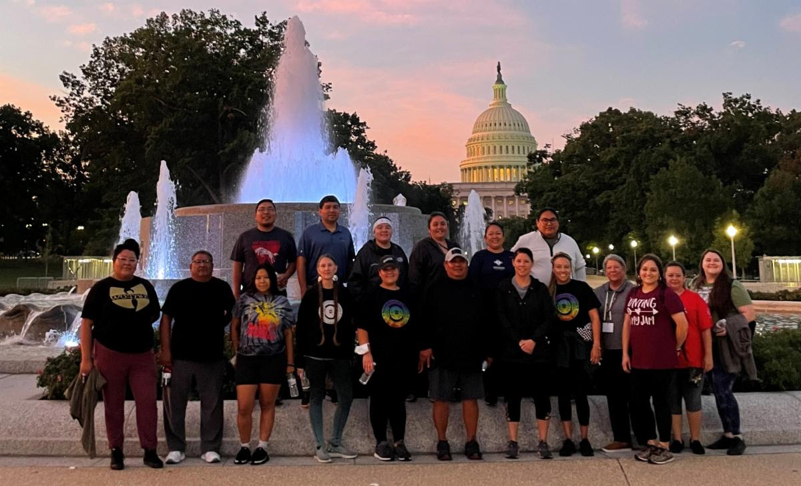
NAIHC Legislative Committee
NAIHC Legislative Conference
Thank You!

Slide 3
NAIHC Legislative Committee
BIG UPDATES
Continuing Resolution:
Congress Passed CR on September 29
Funds Government through December 16
Did not include ERAP Extension
NAHASDA Updates
Two Pathways for Passage
Senate THUD
NDAA Tribal “minibus”

Slide 4
NAIHC Legislative Committee
NAHASDA Reauthorization
NAHASDA Reauthorization, S. 2264
11 bipartisan cosponsors:
Schatz (HI), Murkowski (AK), Tester (MT), Hoeven (ND)
Smith (MN), Cortez Masto (NV), Lujan (NM), Rounds (SD), Warren (MA), Cantwell (WA), Hirono (HI)
Key provisions:
authorize NAHASDA programs through 2032
create an Assistant Secretary for Indian Housing at HUD
re-establish a Drug Elimination Program for tribal communities
Consolidate environment review requirements
recognize tribal sovereignty to govern maximum rent requirements
allow tribal housing programs to access the IHS sanitation funding
make tribes eligible for HUD Housing Counseling grants
HUD-VASH provisions
Leveraging/use as matching other federal funds

Slide 5
NAIHC Legislative Committee
NAHASDA Reauthorization
NAHASDA Reauthorization, S. 2264
Reported out of Committee on February 16
Voice Vote
Next Steps
Increase the sponsor count
Work with Committee to identify other bills to add NAHASDA to as they go through Senate
Two Pathways:
Included in Senate FY23 THUD Appropriations
Amendment to NDAA as part of 14 tribal bill package
Was added to Senate NDAA last year but dropped out

Slide 6
NAIHC Legislative Committee
NAHASDA Reauthorization
NAHASDA Reauthorization, S. 2264
Next Steps for Senate FY23 THUD Appropriations
Work with Leadership to Adopt Senate THUD language over House language
Better $ amounts, NAHASDA provisions
Next Steps for 2022 NDAA
Work with SASC & Senate Leadership
Reed & Inhofe; Schumer & McConnell

Slide 7
NAIHC Legislative Committee
NAHASDA Reauthorization
H.R. 5195
Introduced by Financial Services Chairwoman Maxine Waters
Reported out of Committee on September 15, 2021
Key provisions
Establish an Assistant Secretary for Indian Housing
TDC allowances for energy efficiency upgrades
HUD-VASH
5% Tribal Set-aside for USDA programs
Tribal Eligibility for HUD Counseling grants
Exemption from Flood Insurance Program
184 Tribal Court Jurisdiction Issue
Issues with the bill:
Authorization is set too low: $680M in FY 2022
Contains language targeting Five Tribes in Oklahoma that tribes don’t all support
Hearing in Senate Committee on Indian Affairs on Freedmen Issues on July 28, 2022

Slide 8
NAIHC Legislative Committee
Other NAHASDA Reauthorizations
American Housing and Economic Mobility Act (S. 1368, H.R. 2768)
Re-authorizes NAHASDA for ten years
$2.5 Billion for NAHASDA in first year
Would allow tribes access to Section 8 housing vouchers
Not likely to pass; partisan, national scope bill

Slide 9
NAIHC Legislative Committee
Other Tribal Housing Bills
Native American Rural Homeownership Improvement Act, S. 2092, H.R. 6331
Ten bipartisan cosponsors in Senate:
Smith (MN) and Rounds (SD)
Tester (MT), Thune (SD), Cramer (ND), Schatz (HI), Cortez Masto (NV), Warren (MA), Lujan (NM), Lummis (WY)
Six bipartisan cosponsors in House:
Rep. Dusty Johnson (SD), Rep. Leger Fernandez (NM) & Kahele (HI), Davids (KS), Case (HI), Pocan (WI)
Would provide $50M from USDA Single Family Home Loan program to Native CDFIs to provide home loans in tribal communities
Introduced in June, Subcommittee Hearing Held in July 2021 & January 2022

Slide 10
NAIHC Legislative Committee
Other Tribal Housing Bills
Native American Rural Homeownership Improvement Act, S. 2092, H.R. 6331
Native CDFI Network hosted Webinar
Smith/Rounds Staff
USDA Support
NEXT STEPS:
MORE COSPONSORS – Template Letter For Programs to Send to their Members of Congress
Movement in Committee

Slide 11
NAIHC Legislative Committee
Other Tribal Housing Bills
HUD-VASH
Is included in larger NAHASDA efforts
Included in Senate THUD FY23 Appropriations Bill & NDAA Amendments
Tribal Trust Land Homeownership Act, S. 3381
Four bipartisan cosponsors:
Thune (SD), Smith (MN), Rounds (SD), Tester (MT)
Would establish timeframes for Realty/Land Title processes
Hearing Held on February 16
Reported out of Senate Committee on Indian Affairs on May 18 by voice vote
Included in Senate NDAA Amendments

Slide 12
NAIHC Legislative Committee
Other Tribal Housing Bills
VA Native American Direct Loan Improvement Act
Bill Introduced July 12
Senate VA Hearing Held on July 13
Led by Senator Rounds (SD) and Senator Tester (MT)
Peters (MI) Cosponsor
Address Issues Found in GAO Report: GAO-22-104627
180 Loans Between 2012-2021
Bill would
Allow VA NADL Loans for Refinancing
Grants to Tribal Orgs for Outreach
Relending through Native CDFIs

Slide 13
NAIHC Legislative Committee
Update on Advocacy Campaigns
NAHASDA Reauthorization:
Urging Congress to Reauthorize
NAHASDA, included in THUD
Appropriations Bill
https://p2a.co/K4mCANM
151 Advocates, Over 1,300
Letters to Hill

Slide 14
NAIHC Legislative Committee
FY22/23 Appropriations
Full Year FY22 Passed on March 10th
First Major Increases in Years
IHBG Formula increased to $772 Million (+19.3%)
IHBG Competitive Grant increased to $150 M (+50%)
But Increases Still Keep Tribal Housing Funds below 1998 Adjusted NAHASDA Levels
Percentage of HUD Budget for Tribal Housing Continues to Fall
FY23 Continuing Resolution Means Steady Funding for now (through December 16)

Slide 15
NAIHC Legislative Committee
FY23 Budget/Appropriations
Biden Administration released budget on March 28, 2022
$1 Billion for tribal housing
$772M for IHBG
$150M IHBG Competitive
$70M ICDBG
$7M Training and Technical Assistance
$1M Title VI Loan Guarantees

Slide 16
NAIHC Legislative Committee
FY23 Budget/Appropriations
What about Congress:
House THUD
$1 Billion for tribal housing
$772M for IHBG
$150M IHBG Competitive
$70M ICDBG
$7M Training and Technical Assistance
$1M Title VI Loan Guarantees
Senate THUD
$1.052 Billion for tribal housing
$819M for IHBG
$150M IHBG Competitive
$75M ICDBG
$7M Training and Technical Assistance
$1M Title VI Loan Guarantees
Also Includes NAHASDA!

Slide 17
NAIHC Legislative Committee
FY23 Budget/Appropriations
Next Steps
Work With Members of Congress to Encourage Adoption of Senate language (More $ and NAHASDA)
For Future Years, More Engagement with OMB (Get Increases into Budget Request)
New Tribal Advisor, Liz Carr

Slide 18
NAIHC Legislative Committee
Current HUD & ONAP Grants
FY22 ICDBG (annual)
$92M; NOFO Posted July 19; DEADLINE October 24
FY21 IHBG Competitive
$130M; NOFO Posted July 26; DEADLINE November 17 Extended to January 24
Webinars Set for November 8 & 9
HUD Continuum of Care
FY22 Annual Program Funding – DEADLINE September 30
Unsheltered and Rural Homelessness Additional Funding, (included $50+ Million Rural Set-Aside) DEADLINE October 20

Slide 19
NAIHC Legislative Committee
Emergency Rental Assistance
ERAP funds expired on September 30, 2022
Should not be spending funds except for close out activities
Except Tribes who received additional reallocations, those funds don’t expire until December 29
NAIHC working with members of Congress to extend for one year
Reporting Data as of June 30, 2022:
National Program: $20,493,596,345/$25B = 82.0%
Tribal Program: $411,607,397/$800M = 51.5% (thru March 31)

Slide 20
NAIHC Legislative Committee
Emergency Rental Assistance
Impact
Up to $250 million collectively that could go back to Treasury
Possibly 65% of tribes have some ERAP funds to return
Can we still get extension?
It is possible
Congress often does retroactive changes
Timing/Pathways:
Omnibus Spending or CR (must pass by December 16)
Other package/Standalone
Congress not in session until after midterms
Issues – Altering COVID spending doesn’t get bipartisan support; Senate Banking – Senator Toomey
Targeting Leadership

Slide 21
NAIHC Legislative Committee
Homeowner Assistance Fund
Over 180 tribes have received HAF plan approval and funds
Nearly 100 tribes still have not submitted their HAF plan
NAIHC Trainings
February 28, 2022
Tuesday, March 8
We do have limited T&TA regarding ERAP & HAF
Online form, went out in last few NHUs
https://naihc.net/tribal-housing-assistance-resource-hub/
NAIHC launched webpage to help Native homeowners find ERAP and HAF program

Slide 22
NAIHC Legislative Committee
Update on Advocacy Campaigns
ERAP Extension
Urging Congress to Extend Tribal
ERAP Funds for 1-year
Over 120 Advocates, 1,800 letters
https://p2a.co/Yg8EE8L

Slide 23
NAIHC Legislative Committee
NAIHC Legal Symposium
December 6-7
Bally’s Hotel & Casino Resort
December 5: Legislative Committee
December 6: General Opening Sessions, Two Breakout Blocks, Reception
December 7: Three Breakout Blocks, General Closing Session
Exhibit Hall will be Open, CLEs for Attorneys
Registration Open Next Week!
https://naihc.net/legal-symposium/

