Slide 1
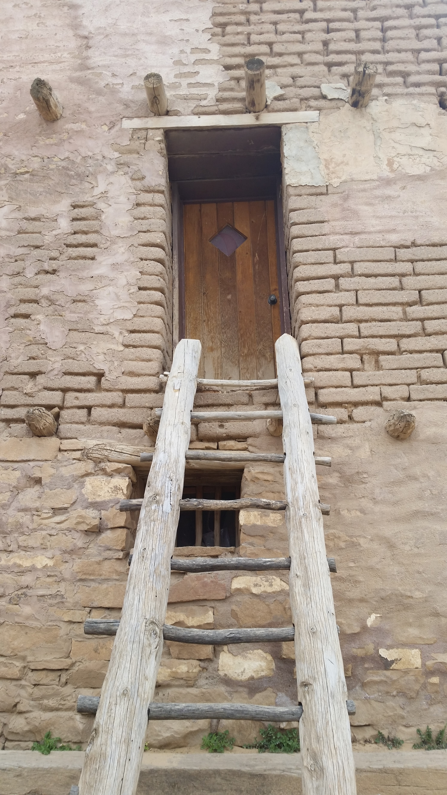




Office of Native American Programs
Southwest Tribal Housing Alliance (SWTHA)
Heidi Frechette, Deputy Assistant Secretary, ONAP
Jody Moses, Administrator
Cheryl Dixon Zuni, Deputy Administrator
May 10, 2022
Notes:
Hello and Good morning
I hope you are staying safe and well. I’m CDZ, DA for SWONAp, also on the call today is Ms. Jody Moses, Administrator for SWONAP.
We always greatly appreciate the invitation to join your meetings to share with you what we know regarding updates on our programs and the happenings within SWONAP.
Thank you to all the SWTHA Board members for allowing us time on the agenda today.
Today, Cheryl Dixon Zuni will share a few updates on each of our programs and other items we find important to pass along.
If you have a question at any time, please do go ahead and ask. I will be monitoring the chat and entering the links that Cheryl references throughout the presentation.

Slide 2

New Staff at SWONAP
Jack Edmo, Jr., Grants Management Director, Albuquerque.
Mr. Edmo began his work within the seven tribal communities in Montana. Recognizing the impact of performance improvement in the delivery of services was a critical step in being responsive to the needs of the tribe.
Mr. Edmo’s years at the Bureau of Indian Education, the 21st Century Community Learning Centers. Mr. Edmo successfully ensured 100% in compliance with grant requirements. He
accomplished this by building effective relationships with the grantees.
Most recently, Mr. Edmo was with the Bureau of Indian Affairs, Office of Self-Determination. He transitioned the training format, from lecture style on-site training to the Department of the Interior’s internal learning management system. Training is now accessible on a system-wide on-demand platform.
Mr. Edmo is of the Blackfeet Nation in Northern Montana and Shoshone Bannock Eastern Idaho.

Slide 3
Office of Native American Programs
Program Info & Updates
Notes:
Hello and Good morning
I hope you are staying safe and well. I’m CDZ, DA for SWONAp, also on the call today is Ms. Jody Moses, Administrator for SWONAP.
We always greatly appreciate the invitation to join your meetings to share with you what we know regarding updates on our programs and the happenings within SWONAP.
Thank you to all the SWTHA Board members for allowing us time on the agenda today.
Today, Cheryl Dixon Zuni will share a few updates on each of our programs and other items we find important to pass along.
If you have a question at any time, please do go ahead and ask. I will be monitoring the chat and entering the links that Cheryl references throughout the presentation.

Slide 4

Section 184 Home Loan Guarantee
Section 184 guaranteed loans can be used, both on and off native lands, for new construction, rehabilitation, purchase of an existing home, or refinance.
Southwest | Arizona | New Mexico | Nevada | California
2021 | Firm Commitments:156 LGCs: 150 | Firm Commitments:154 LGCs: 104 | Firm Commitments:16 LGCs: 27 | Firm Commitments:228 LGCs: 188
2022 (January-March 31) | Firm Commitments: 21 LGCs: 80 | Firm Commitments:18 LGCs:15 | Firm Commitments:2 LGCs:74 | Firm Commitments:42 LGCs: 96

Slide 5
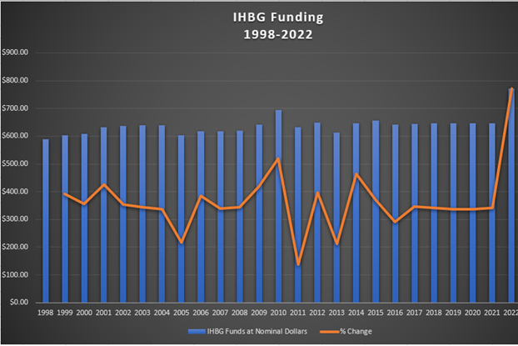
Indian Housing Block Grant (IHBG)
Formula
FY 2022 Allocation: $772MM
The biggest increase in program history.
Increase needed given historical flat-funding and rising inflation.
  *FY 2021-$647MM

Slide 6
Indian Community Development Block Grant
(ICDBG)
  FY 2021 Applications-Award announcements expected this month (May 2022)
  Approximately $70 MM appropriated nationwide; $24.3MM in SW for FY 21 NOFO.
  FY 2022-$72.086 million
    Of this amount, no more than $5 million is for ICDBG Imminent Threat grants. This is an increase from the usual $4 million ceiling for ICDBG IT grants that we’ve seen for many years.
    Draft FY2022 NOFO-No publication date yet.
Notes:
Update

Slide 7
Indian Housing Block Grant – Competitive Program
(IHBG-COMP)
FY 2021 NOFO Applications were due January 4, 2022
  Nationwide Competition. Approximately $95MM available nationwide in FY 21 NOFO.
  Application currently in review
FY 2022 Allocation-$150 million
  This is a $50 million increase from prior years
  The maximum award cap has been raised to $7.5 million
For any questions on this Program, Please contact SWONAP GMS:
  John Gissel at 602.379.7149 or at John.W.Gissel@hud.gov

Slide 8
Indian Housing Block Grant – CARES
(IHBG-CARES)
Funds can be used for a broad range of activities. This includes all eligible IHBG affordable housing activities, as well as additional flexibilities provided under the various waivers and alternative requirements included in PIH Notice 2021-14 https://www.hud.gov/sites/dfiles/PIH/documents/PIH2021-14.pdf
If your communities’ needs and circumstances have changed since you first submitted your Abbreviated Indian Housing Plan (IHP), you can amend your plan and carry out new or different activities or projects using your IHBG-CARES funds. Contact your GMS.

Slide 9
Indian Housing Block Grant – American Rescue Plan
(IHBG - ARP)
If you have not yet submitted your IHBG-ARP Abbreviated IHP, please do so.
  Activities to Prepare, Prevent, and Respond to Covid-19 Pandemic
  Funds can be used for a broad range of activities. This includes all eligible IHBBG affordable housing activities, as well as additional flexibilities provided under the various waivers and alternative requirements included in PIH Notice 2021-14 https://www.hud.gov/sites/dfiles/PIH/documents/PIH2021-14.pdf
There are T/A funds available
For questions regarding your ARP Program, please contact your GES-ARP:
Candice Millsap, Candice.E.Millsap@hud.gov
Max Amaechi, Uluocha.N.Amaechi@hud.gov
Zuania Troche-Santiago, Zuania.Troche-santiago@hud.gov

Slide 10
Tribal HUD VASH
Renewal Notice Published. Deadline is May 27, 2022
Notice PIH 2022-08-Notice announces renewal requirements for the original 26 Tribal recipients, HUD-VASH recipients awarded in 2015, and five (5) Tribal HUD-VASH Round I Expansion recipients awarded in 2021.
https://www.hud.gov/program_offices/public_indian_housing/ih/tribalhudvash

Slide 11

Grants Evaluation and Management System (GEMS)
Modernizing its IT Systems to improve the administration of Tribal housing programs to simplify the grant management processes for our recipients including modernizing the administrative and reporting systems
Will not change current program and grant administration requirements
GEMS will replace EPIC to centralize, and streamline required submissions and communications
Testing of the system has started and ongoing
Once complete, ONAP will roll-out GEMS in stages by Grant Programs with IHBG being released first
Training Webinars will be hosted and announced in the near future.
Coming Soon!

Slide 12
ONAP’s
Tribal Climate Resilience and Adaptation Website
ONAP has created a Tribal climate resilience and adaptation website specifically for Tribes. https://www.hud.gov/program_offices/public_indian_housing/ih/tribal_climate_resilience_and_adaptation
The site pulls together tools and resources that are tailored to Tribes, including maps, data sets, and adaptation plans.
Website also includes information on Federal funding that supports Tribes addressing climate change, as well as case studies.
Technical assistance is available to help Tribes achieve climate planning and adaptation activities.

Slide 13
Upcoming Trainings…
May 24 IHBG ARP Project Implementation
May 24-27 Basic Financial Management & Audit Preparation for Small Tribes
Jun 6-8 Admissions & Occupancy
Jun 7-8 Program Income Training
June 14 Tribal HUD-VASH Essentials Training
https://www.hud.gov/program_offices/public_indian_housing/ih/codetalk/calendar
For Specific Training and Technical Assistance Requests
  Please contact your SWONAP Grants Management Specialist

Slide 14

Questions
    Thank you!
    Have a great meeting & training!

Slide 15
SWONAP Contacts
Jody A. Moses, Administrator (Phoenix) Jody.A.Moses@hud.gov
Cheryl Dixon Zuni, Deputy Administrator (Albuquerque) CherylDixonZuni@hud.gov
Robert J. Holden, Grants Management Director (Phoenix) Robert.J.Holden@hud.gov Jack Edmo, Grants Management Director (ABQ) Jack.Edmo@hud.gov | Jan E. Oleksak, Grants Evaluation Director (Phoenix) Jan.E.Oleksak@hud.gov Ginger Moralez, Grants Evaluation Director (ABQ) Ginger.J.Moralez@hud.gov
VISIT OUR WEBSITES:
Codetalk:
https://www.hud.gov/program_offices/public_indian_housing/ih
SWONAP:
https://www.hud.gov/program_offices/public_indian_housing/ih/codetalk/onap/swonap
SECTION 184:
https://www.hud.gov/program_offices/public_indian_housing/ih/homeownership/184
TITLE VI:
https://portal.hud.gov/hudportal/HUD?src=/program_offices/public_indian_housing/ih/homeownership/titlevi
COVID-19 Recovery Programs:
https://www.hud.gov/program_offices/public_indian_housing/ih/Covid_Recovery

