Slide 1
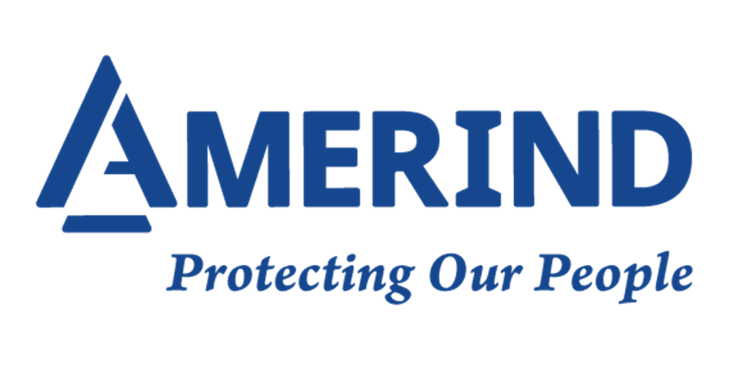
Southwest Tribal Housing Alliance
AMERIND Update
January 2022

Slide 2
Executive Summary
Objective
Provide an update on operational performance of AMERIND’s Tribally Focused Programs.
Mission Update
1) Be here for as long as Tribes need us
2) Keep Indian money in Indian Country
Sustainability Ratios Operating Losses &
Target Loss Expense Operating Revenue Operations
65% 30% 95%
Performance
NAHASDA 105% 17% 90% $16.04M $19.58M
2020 Dec 87% 18% 62% $15.97M $15.17M
NAHR 88% 16% 95% $7.93M $8.22M
2020 Dec 110% 21% 120% $6.99M $9.13M

Slide 3
Executive Summary (Continued)
Sustainability Ratios Operating
Target Loss Expense Operating Revenue % Change
65% 30% 95%
Performance
TGB 75% 19% 80% $15.50M 27% increase
2020 DEC 81% 22% 80% $11.33M 17% increase
TWC 26% 15% 33% $14.10M 35% increase
2020 Dec 49% 24% 56% $ 9.19M 7% increase
AMERIND Re Target Actual
Performance 100% 98% $ 5.83M 10% increase
2020 Dec 100% $ 5.27M 7% decrease
Operational Highlights through December 31, 2021
Core program – IHBG (NAHASDA) performed at 122% with loss from operations of $3.54M
before investment income of $5.2M.
All other programs - performing at 90% with income from operations of $5.55M
Net investment income and other expense: $8.77M
Net position increased $15.4M

Slide 4
Executive Summary (Continued)
2021 Staffing
Jobs at AMERIND – 59% Native American operated/ 90% AINS Designated
As of 12/31 Budgeted
2019 FTE 2020 FTE 2021 FTE 2022 FTE
Total Staffing 52 54 62 70
Diversification of Income Streams
2012 2020 2026
NAHASDA 56% 33% 27%
NAHR 16% 16% 15%
TGB 15% 24% 28%
TWC 13% 17% 19%
All Other 0% 9% 11%

Slide 5
Hard Reinsurance Market
Causes:
Increase in frequency & severity of CAT events
Climate change - named & convective storms, wildfires, drought, etc.
Social Inflation
Uncertainty due to COVID-19
Effects:
Reduction in available capital
Reduction in available limit
More reinsurers needed to fill same limit = > Cost
$1.2M in additional premium for 2020 true-up
Impact on 2021 Renewal:
40 – 50% rate increases with certain lines seeing 80-90% increases
Exclusion: Communicable disease (COVID-19)

Slide 6
Loss Performance
5th Consecutive year of higher-than-expected losses:
Historically run $13M - $15M
Historically 1 bad year followed by 2 good years
20%-25% increase in construction costs
70% of loss costs – fire related
Severity of loss is increasing
Wild-fire, named & convective storms, liability, cyber
Expecting to pay out over $20M for 2021
Impact on External Reinsurance:
Impacted both Per Risk & CAT Treaties
Drove costs up and coverage offerings down
Additional exclusions: Wildfire exposures, AK liability limit, MFA/EPD
Impact on Internal Reinsurance (AMERIND Re):
Stop loss paid out $3 Million for NAHASDA (IHBG)

Slide 7
Reinsurance Market – 2022 Renewal
Impact on 2022 Renewal:
15-20% rate increases
Required to take higher retentions
Reduced coverage
External Reinsurance:
Continued constriction of limit/coverage
Changing UW Guidelines
Additional exclusions: Wildfire exposures, MFA/EPD
Internal Reinsurance (AMERIND Re):
Increased dependence – offset higher retentions/fill gaps

Slide 8
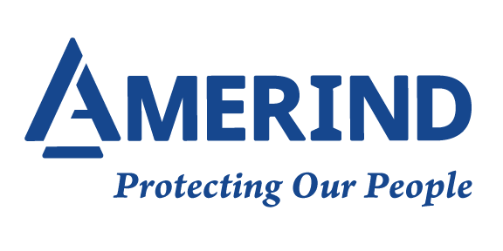
THANK YOU

