Slide 1
Providing services to rural communities since 1978

Slide 2
RCAC’s mission and vision
RCAC provides training, technical and financial resources and advocacy so rural communities can achieve their goals and visions.
RCAC envisions vibrant, healthy and enduring rural communities throughout the west.

Slide 4
THE Academy
THE Academy is a three-year initiative to work with innovative rural TDHEs and housing departments to build capacity to manage the housing development process
The goal is to increase housing on native lands
We emphasize leveraging IHBG with other funding that is not yet widely accessed by native communities

Slide 5
What THE Academy Includes
Combines training with technical assistance to apply lessons directly to your housing project
Three-year program offers:
  Six training sessions spread over 18 months
  Shorter webinars in between on special topics
  Coaching for your housing project over 3 years
Participants commit to:
  Staff time for same two staff to attend all trainings, plus time to work on your housing project
  Travel costs for in-person trainings

Slide 6
Who THE Academy Is For
Eligible applicants are IHBG or NHHBG grantees:
  Tribal or Native housing authorities, TDHE’s, housing departments
The housing must be Rural by HUD Rural Capacity Building Grant definition
Successful applicants will have:
  Some recent development experience
  A viable housing project to work on
  A desire to stretch/innovate

Slide 7
How to Apply
Accepting applications this summer & fall
THE Academy trainings will be winter 2021 to spring 2023, and coaching through fall 2024
To receive information or an application
send an email to
THEAcademy@rcac.org

Slide 8
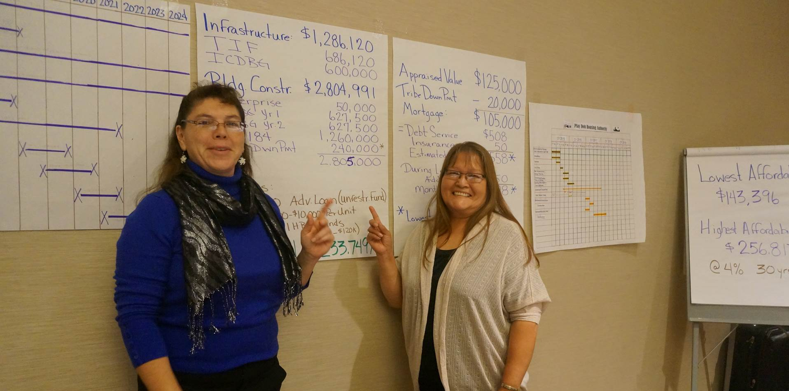
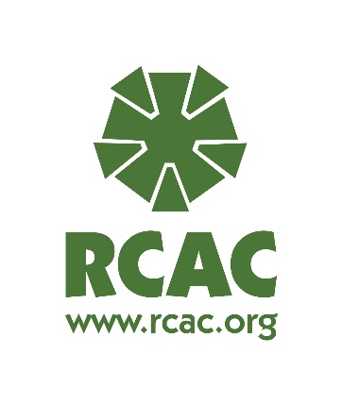
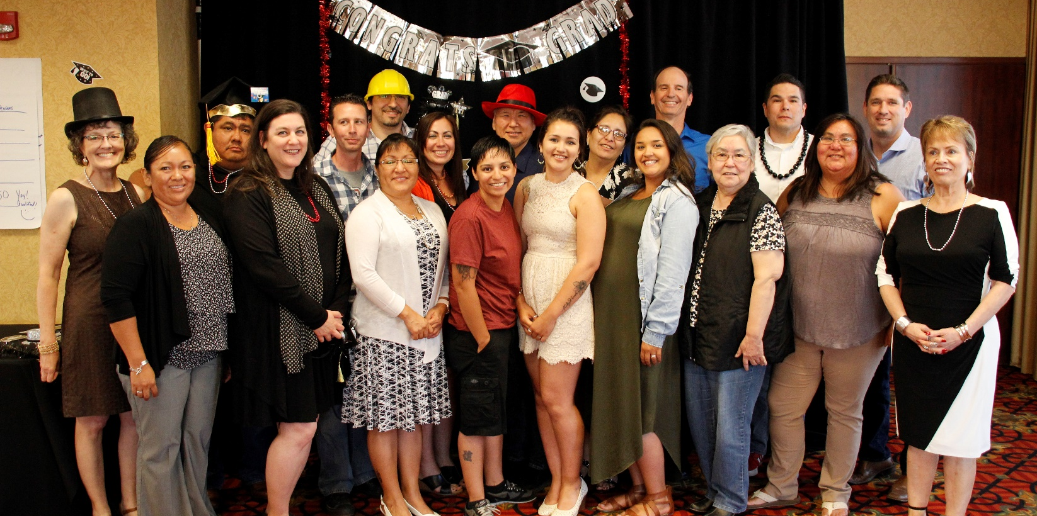

Come have fun with us!

