Slide 1
Opportunities for Communities and Rural Partnerships

Slide 2
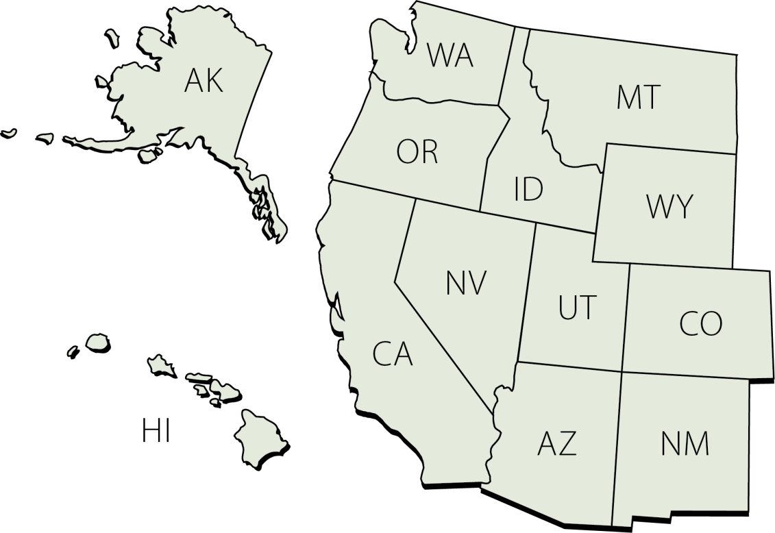
Rural Community Assistance Corporation
RCAC
Serving 13
western
states
and the
Pacific Islands

Slide 3
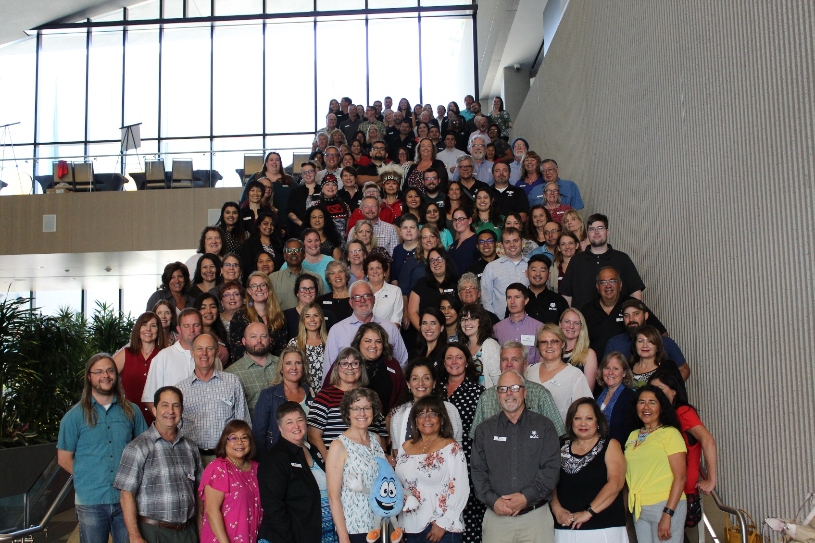
Why do we CARE???

Slide 4
RCAC’s Mission & Vision
Creating opportunities in rural America
Provides training, technical and financial resources and advocacy so rural communities can achieve their goals and visions.
Envisions vibrant, healthy and enduring rural communities throughout the west.
Key values: leadership, collaboration, commitment, quality and integrity.

Slide 5
Who We Serve
Tribal organizations
Rural communities and organizations
Farmworkers
Notes:
RCAC envisions vibrant, healthy and enduring rural communities!

Slide 6
Capacity Building Access to Resources Technical Assistance Training Advocacy
Five Core Services

Slide 7
Our Services for Housing
Development Solutions
Tribal Housing Excellence Academy
Coming Soon! THE Development Essentials
Building Rural Economies
Mutual Self-help Housing TA
HUD Housing Counseling
502 Direct Packaging Program
Loan Fund
Notes:
What is in Green is what I will be presenting more information on.

Slide 8
Development Solutions
Dave Ferrier
dferrier@rcac.org
Rental Housing Development

Slide 9
Our Goals
Encourage and build the capacity of the rural housing network
Tribes and Native communities have capacity to build affordable housing

Slide 10
Roles We Play
Technical Assistance funded by grants
Capacity building
Project assistance and guidance
Consulting
Partnership with local Tribes and TDHE
Development partner
Possibly long-term owner partner

Slide 11
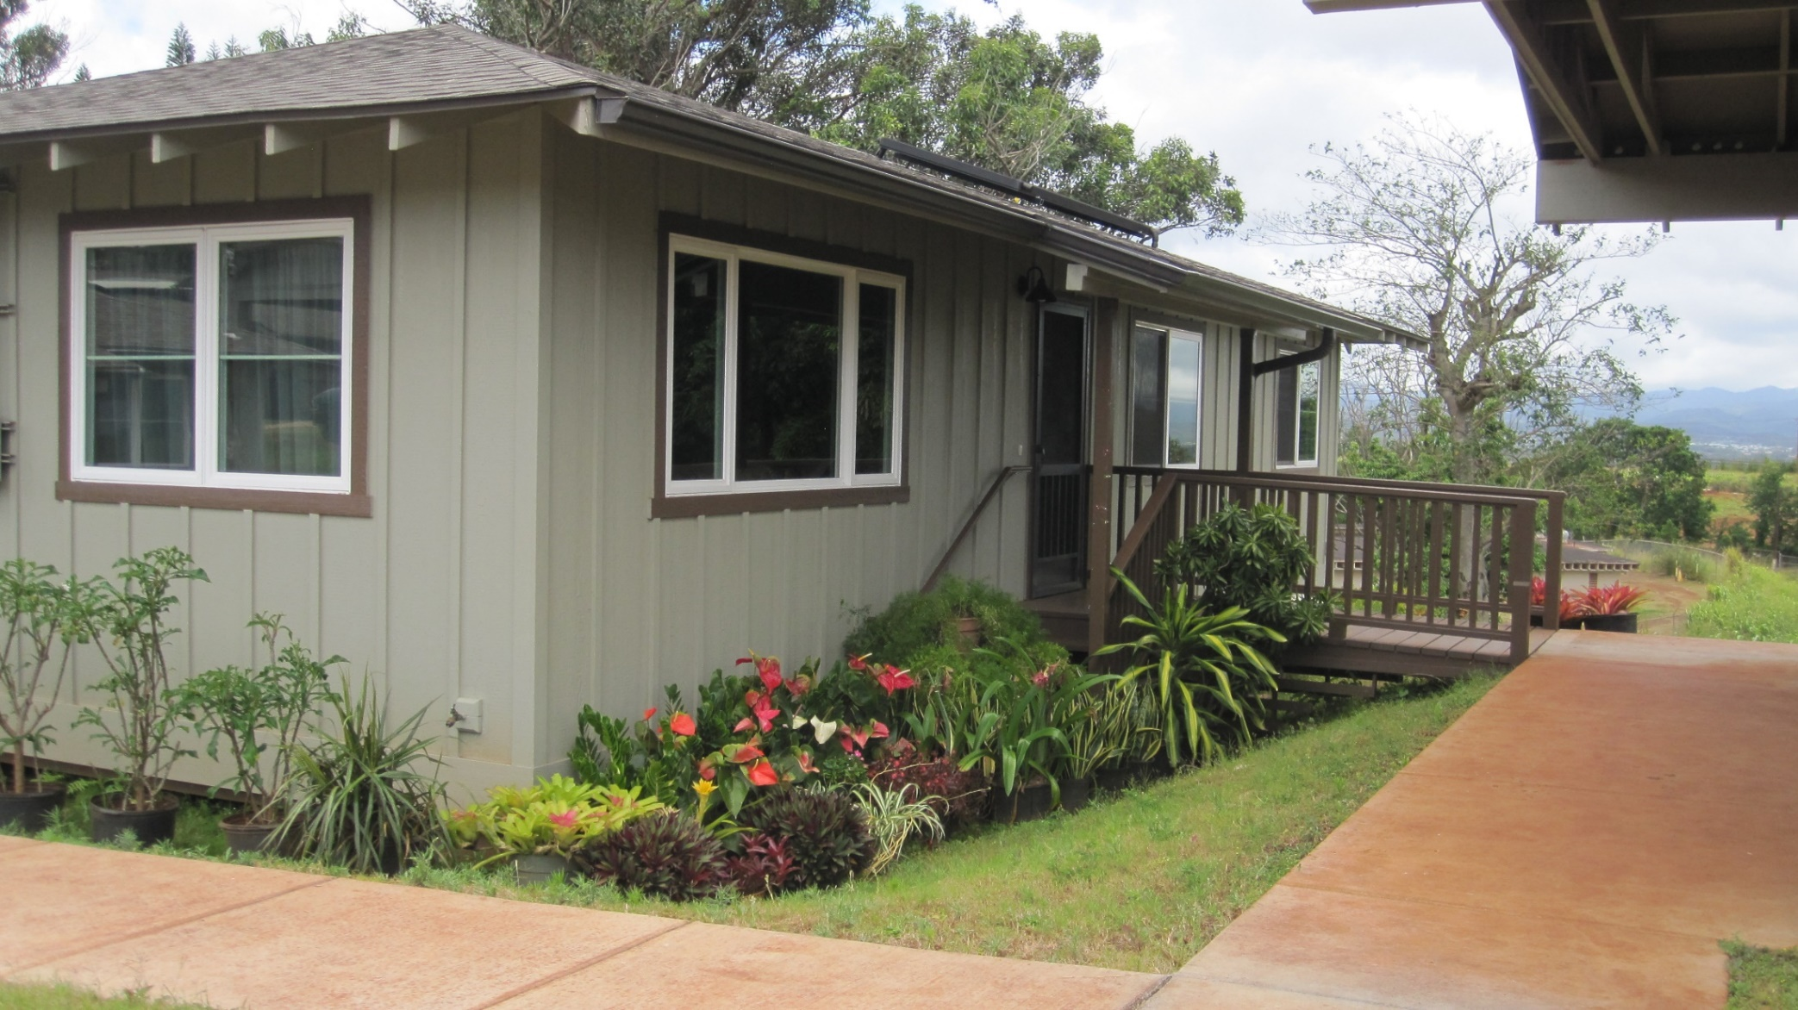
Kunia Village

Slide 12
Courtyard Apartments, Kalispell Montana
Notes:
Local Partner is Community Action Partnership of Northwest Montana
Rehabilitation of 32 rental units
$5.1 Million
LIHTC, AHP, Glacier Bank, CAPNM Equity
complete January 2019

Slide 13
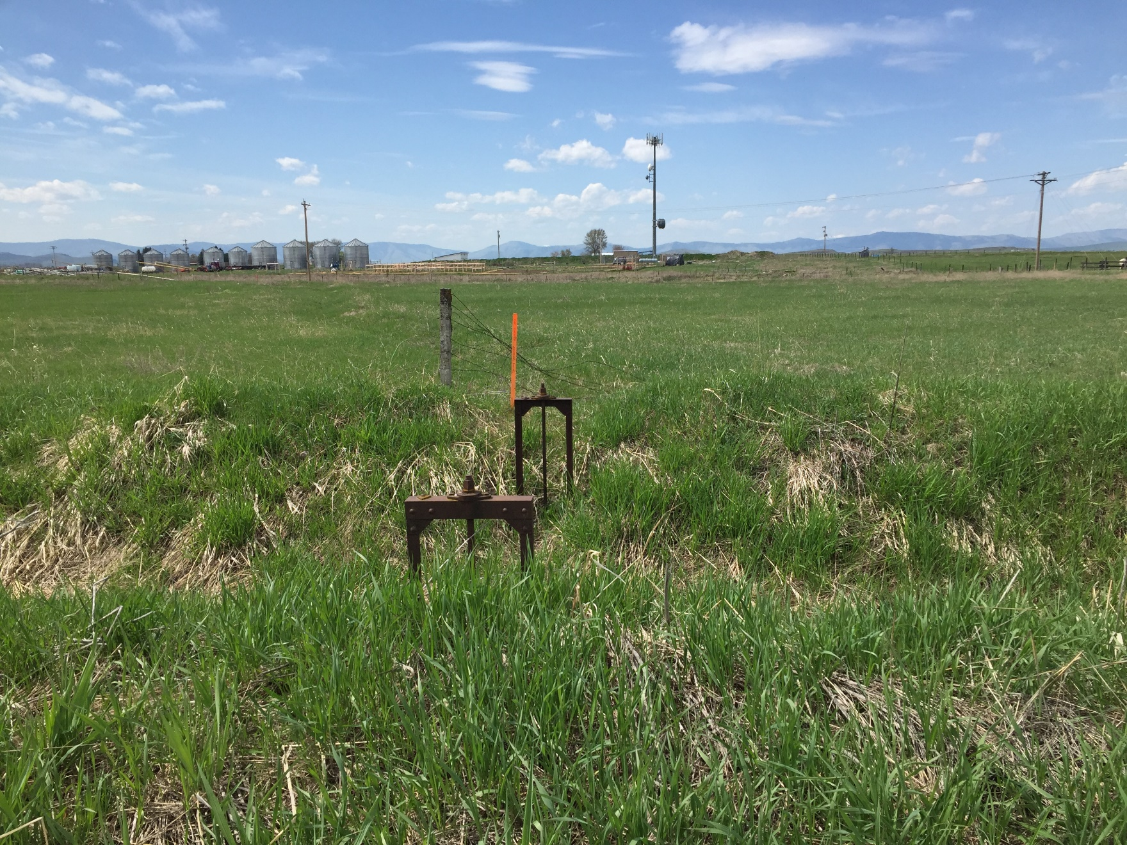
Meadowlark Apartments, Ronan Montana
Notes:
Ronan, Montana
Local Partner is Lake County Community Housing Organization
Two Phase 24 Units and 16 Units
$3.6Million and 300-500 feet of sewer line
LIHTC, NHTF, HOME, CDBG
Fall 2019

Slide 14
Established
in ◊ 2014 ◊
Notes:
I think THE Academy started on 2015

Slide 15
Tribal Housing Excellence Academy
Goal is to increase the variety and volume of housing on native lands
Emphasis on leveraging IHBG with other funding that is not yet widely accessed by native communities

Slide 16
What THE Academy Offers
Combines training with technical assistance to apply lessons directly to a housing project
Multi-year program offers:
Five training weeks spread over 18 months
Coaching for a housing project between trainings and for a year after
Participants commit to sending two staff to all the trainings, plus time to work on the housing project
Commitment of staff time and travel cost

Slide 17
Who Is THE Academy For?
Eligible applicants are NAHASDA grantees:
Tribal housing authorities/TDHE’s/housing departments
Successful applicants will have:
Some recent development experience
A viable housing project to work on
A desire to stretch/innovate

Slide 18
W-Di
Notes:
Santo Domingo Tribal Housing Authority
Wait list analysis – changed from HO to rental, and sizes for families
Artist sheds

Slide 19
THE Academy – fun with many hats

Slide 20
THE Academy – Next Round
Will apply for funding in 2020
If successful, application process will open in winter 2020.
May be open to nonprofits in partnership with tribes
Contact
Eileen Piekarz
EPiekarz@rcac.org

Slide 21
DEVELOPMENT ESSENTIALS
Established
in ◊ 2019 ◊
COMING SOON!

Slide 22
Who Is THE Development Essentials For?
NAHASDA grantees & TDHEs
Key representatives from:
Housing Staff
Tribal Councils
Housing Boards
Native CDFIs
Planning Departments

Slide 23
New Course
Three-day course
Offered 3 times in 2020
Potential Cities: Spokane, Phoenix, Denver
Participants commit to attend all 3 days
Some scholarships available (Details TBD)

Slide 24
What THE Development Essentials Offers
Introduction to housing development
Wait-list analysis – your own needs
Introduction to lending
Overview of leveraging funding sources
Development team

Slide 25
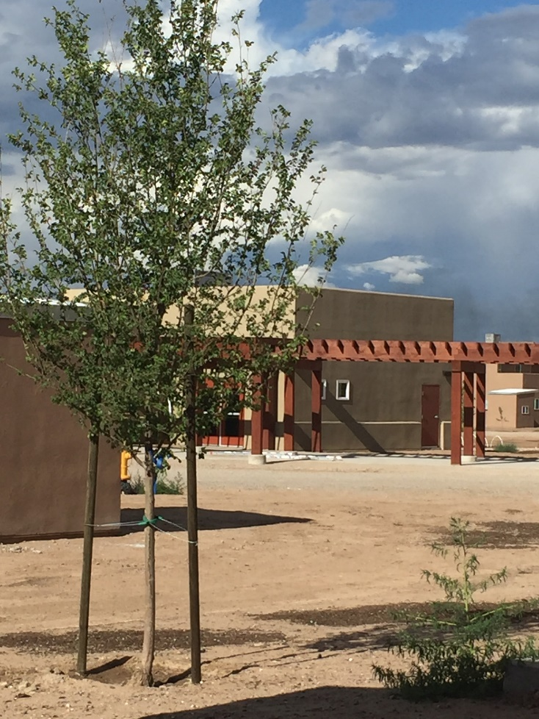
Who To Contact?
Erika Holzhauer
eholzhauer@rcac.org

Slide 26
Housing Counseling
Teresa Bardwell
tbardwell@rcac.org
https://www.rcac.org/housing/housing-counseling/hud-approved-counseling-agency/

Slide 27
Seeking Housing Counseling Agencies
HUD Housing Counseling grant funding passed through RCAC
Conditional approval as a HUD Housing Counseling Agency through RCAC’s affiliation
RCAC Training scholarships, place-based training opportunities as available
Affiliation with a network of housing counseling agencies within the rural Western United States
Assistance through TA and monthly webinars with program compliance, designing forms, program updates

Slide 28
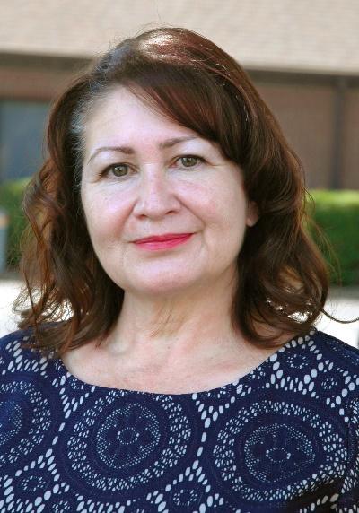
RCAC Loan Fund
Juanita Hallstrom
JHallstrom@rcac.org

Slide 30
Building Rural Economies
Pam Higgins
PHiggins@rcac.org
Established
in ◊ 2013 ◊

Slide 31
Contact RCAC
RCAC website: www.rcac.org
Erika Holzhauer
eholzhauer@rcac.org
(707) 349-8556

