Slide 1


White Mountain Apache Housing Authority
Jeremiah Kessay
Maintenance Supervisor
& Meth Awareness Team Coordinator

Slide 2

Fort apache Indian Reservation
Northeastern central Arizona
1.6 million acres | 18,000+ tribal members
Wmaha is TDHE and manages 1,188 units
tax credit, low rent, & apache dawn (home owners)

Slide 3
Our meth remediation History
Began testing units in 2015
14 units tested positive for meth
Created reservation-wide Meth Awareness Team
Started reaching out to other housing authorities to see what they’re doing and if they have a problem with meth in their units

Slide 4
meth remediation research
Internet search on ways to clean meth
Consulted with vendors
Determined need for certified cleaners and maintenance crew

Slide 5
Our Process today
Have the unit tested by security.
If positive by security, have the unit professionally tested.
Have contractor clean the unit and retest.
Wait for test results.
Have the unit professionally cleaned again if still positive.
When test results come back with safe levels, then maintenance will start the clean up procedures.

Slide 6
Meth cleaning process
The cleaning process is supervised by a certified supervisor, the first thing that is cleaned in a whole unit is the HVAC, then the ceiling and walls then floor.
The cleaning of the HVAC is done with a heap vac and duct cleaning machine.
The ceiling and walls are cleaned with a pressure washer set between low and medium. The pressure washer is used to spray on the cleaning agent and for rinsing.
The ceiling walls and floor are scrub, rinse and the water is vacuum up into a storage tank.
A unit is washed a total of three times and could take up to 4 hours for one unit.

Slide 7
What is consider a safe level?
Most state’s adopted a level that is considered safe. These levels range is the area of: 1.05, 1.0, 0.5
Arizona has one of the highest levels in the nation at 1.5
White mountain apache housing authority adopted a level of 0.033
Wmaha has seen levels as high as 48.0, 62.0, 93.0, 110.0

Slide 8

Our challenges
Engaging community in efforts to decrease drug use
Need for new policies & procedures
Housing conditions
Adequate funding
Remediation
Political intervention
Outreach and education
Court systems
CPS

Slide 9
Our proposed Solutions
Expand efforts of meth awareness team
Adopt WMAHA policies & procedures
Enact WMAT resolution to mandate a representative from every tribal department participate in meth awareness team meetings
Update WMAT criminal codes- tribal law, fines & sentencing

Slide 10
NAIhc resolution 18-02
Provide a separate source of funding, not to be offset by existing Indian housing funding, at a minimum of $200 million per year, to tribes and TDHEs to address the cost of identification, assessment, remediation, and prevention of environmental and drug risks in our housing units and communities;
Create a National Environmental and Drug Task Force in Indian Country comprised of TDHEs and other relevant stakeholders and federal agencies;
Convene a National Environmental and Drug Summit for Indian Country in FY 2019; and
Include methamphetamine awareness and prevention efforts along with the federal government’s response to opioid crisis in Rural America.

Slide 11

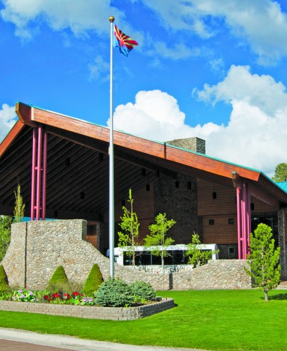
Our invitation
SWTHA
Meth Remediation Roundtable
August 2019
Hon-Dah Casino
To share information and strategize as a region

Slide 12
