Slide 1
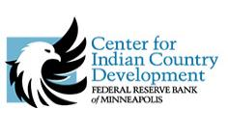

Tribal Leadership & Institutional Impacts on Homeownership
Craig Nolte, Regional Director, Community Development
Federal Reserve Bank of San Francisco
Contributor, Center for Indian Country Development
Federal Reserve of Minneapolis
The views, opinions, findings, conclusions, or recommendations expressed here are those of Craig Nolte and not necessarily those of the Federal Reserve System

Slide 2
Today’s Discussion
Center for Indian Country Development | National Native Homeownership Coalition (NNHC)
Challenges to Homeownership in Indian Country
What Tribes, Banks, and Agencies Can Do to Help Homebuyers
Next Steps
Discussion

Slide 3
  Four Areas of Focus
Land
Homeownership
Support the best economic use and effective governance of land
Provide resources for tribal and private businesses and support entrepreneurship development
Support a better understanding of homeownership opportunities and challenges
Education
Highlight effective educational and training programs, and explore achievement and funding gaps
Business & Entrepreneurship

Slide 4


5 Working Groups /
200+ members
Capital and Secondary Markets
Lending Systems
*Tribal Leadership Support
Homebuyer Readiness
Data and Research
Many Objectives
Expand access to credit
Streamline lending process
Identify policy gaps
Highlight best practices
Establish Resource Clearinghouse
Track economic impact
Develop a homeownership guide for tribal leadership

Slide 5

Tribal Leadership Support Working Group
~ working with tribal leaders to promote homeownership
Why homeownership?
What are some challenges to homeownership?
How can tribal leaders support homeownership?
Notes:
We can keep the “Why Homeownership” discussion shorter as I will

Slide 6
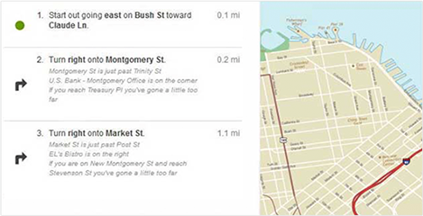
Different Routes, Different Results
Here
There

Slide 7
Challenges & Opportunities to
Homeownership in Indian Country
Information about housing options for tribal members on Indian reservations
Coordination among tribal and federal agencies
Communication among tribes, lenders, and agencies
Appraisal process and comparables
Government lending programs

Slide 8
Challenges and Opportunities to
Homeownership in Indian Country
BIA review and approval process
Environmental reviews
Incentives to lenders to work in Indian Country
Credit history of borrowers
Access to lenders

Slide 9
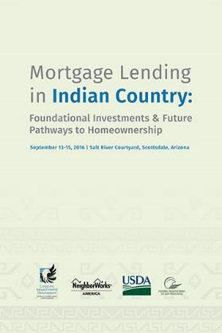
How can we promote more homeownership?
Streamlined lending processes
Better homebuyer education and preparation
Tribal leadership that supports the homeownership option
Tribal legal infrastructure to support lending & recourse

Slide 10
What Can Tribes Do?
Identify one department to lead homeownership efforts
Conduct a homeownership needs assessment
Promote the message that homeownership is possible
Prioritize financial education opportunities
Enact mortgage/foreclosure ordinance
Conduct land-use planning
Allocate financial resources to support homeownership

Slide 11
What Can Tribes Do?
Ensure tribal members have housing choices:
  HUD Section 184 Indian Housing Guarantee Program
  USDA RD 502 Direct Program
  VA NADL
  Conventional mortgage lenders
Establish a tribal leasing program for business and home sites
Enact tribal laws that support mortgage lending and recourse for lenders
Make homebuyer and financial education a tribal priority
Appoint a mortgage counselor and train appraisers and home repair skills
Encourage savings and asset building

Slide 12
Tribes without Veterans Affairs
Native American Direct Lending Program
Arizona
Ak Chin Indian Community of the Maricopa Indian Reservation
Colorado River Indian Tribes of the Colorado River Indian Reservation
Fort Mojave Indian Tribe
Havasupai Tribe of the Havasupai Reservation
Hopi Tribe of Arizona
Quechan Tribe of the Fort Yuma Indian Reservation
San Juan Southern Paiute Tribe of Arizona
Tohono O’odham National of Arizona
Contact
Richard Givot, Department of Veterans Affairs, Loan Guaranty Service Program Analyst, WA, DC
(202) 461-9553
richard.govot@va.gov

Slide 13
Tribes without Veterans Affairs
Native American Direct Lending Program
New Mexico
Jicarilla Apache Nation
Mescalero Apache Tribe of the Mescalero Reservation
Navajo Nation
Pueblo of Acoma
Pueblo of Jemez
Pueblo of Nambe
Pueblo of Picuris
Pueblo or Pojoaque
Pueblo of San Felipe
Pueblo of San Ildefonso
Pueblo or Sandia
Pueblo or Santa Ana
Pueblo of Santa Clara
Pueblo of Taos
Pueblo of Tesuque
Pueblo of Zia
Ute Mountain Ute of the Ute Mountain Reservation
Contact
Richard Givot, Department of Veterans Affairs, Loan Guaranty Service Program Analyst, WA, DC
(202) 461-9553
richard.govot@va.gov

Slide 14
Tribes without Veterans Affairs
Native American Direct Lending Program
Texas
Kickapoo Traditional Tribe of Texas
Alabama-Coushatta Tribe of Texas
Contact
Richard Givot, Department of Veterans Affairs, Loan Guaranty Service Program Analyst, WA, DC
(202) 461-9553
richard.govot@va.gov

Slide 15
Tribes without HUD/ONAP Section 184 Loan Guarantee Program
Arizona
Ak-Chin Indian Community of the Maricopa Indian Reservation
Havasupai Tribe of the Havasupai Reservation
Tonto Apache Tribe of Arizona
New Mexico
Pueblo of Picurus
Pueblo of Acoma (under review)
Pueblo of Santa Ana (under review)
Texas
None
Contact
Andrea V. Dunyon
SWONAP – Team Lead and Program Environmental Specialist
Southwest Office of Native American Programs, HUD
602-379-7202
andrea.v.dunyon@hud.gov

Slide 16
What can Banks Do?
Offer mortgage products that work better on trust lands
Request TSR and environmental reviews at time of application
Provide incentives for loan officers
Meet with tribes to better understand the communities’ needs
Work with Native CDFIs, who provide financial, administrative, and education support
Facilitate down payment assistance programs: tribe, Federal Home Loan Banks, state housing agencies
Seek CRA opportunities

Slide 17
What Banks Can Do:
Community Reinvestment Act
Loans
Any type, anywhere
Purchase loans from CDFI
Investments
Grants
Donations
Purchase bonds
LIHTCs, NMTCs
Services
Improve access to financial services for tribes and tribal members
Serve on a CDFI’s Board of Directors, advisory board, loan review committee
Homebuyer class instructor
Develop new product for CDFI and provide technical assistance with marketing

Slide 18
What Can Agencies Do?
Hold regular interagency meetings on mortgage process
Combine training with partner agencies
Provide clear and consistent mortgage processing procedures within and between regions
Develop a tracking system
Instill accountability – internal & external audits

Slide 19
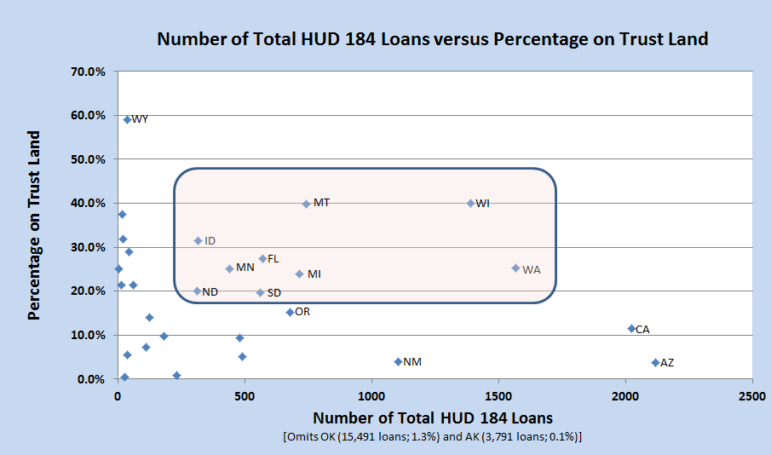
We can change the mortgage lending paradigm from fee land to trust land!

Slide 20


Craig Nolte, Regional Director, Community Development
Federal Reserve Bank of San Francisco
craig.nolte@sf.frb.org (206) 396-2192
Contributor, Center for Indian Country Development
Federal Reserve of Minneapolis

