Slide 1
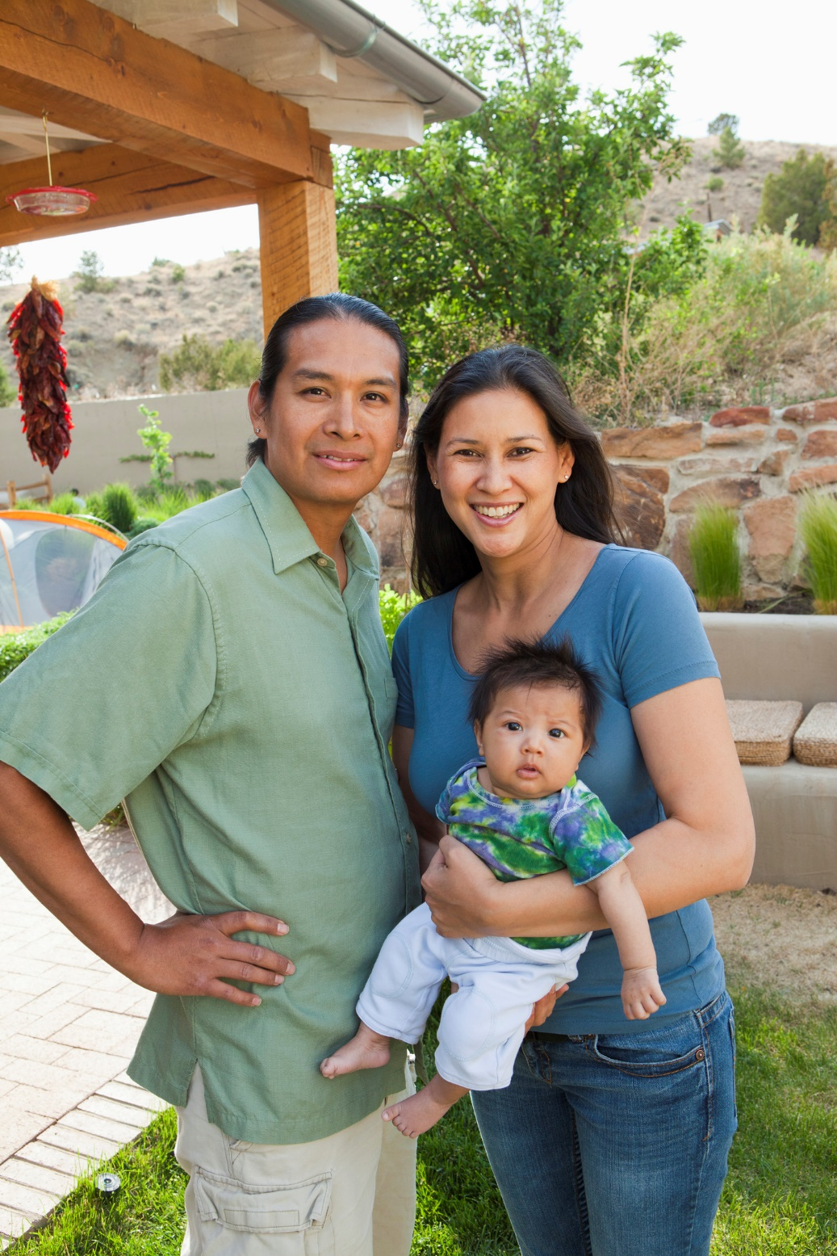
Southwest Tribal Housing Alliance Meeting
January 31, 2018
Working Together to Make Affordable Housing a Reality
for Your Community

Slide 2
Agenda
Who Is Fannie Mae and What Do We Do
What Is Duty to Serve
Who Are Fannie Mae’s Partners
Efforts and Outreach in 2017
Learnings
HomeReady Benefits and Eligibility
Research Project in 2018
Accomplishments in 2018
How can we help and contact information

Slide 3
Who Is Fannie Mae and What Do We Do?
Fannie Mae’s mission is to expand homeownership. We have a special focus on helping underserved Americans overcome the unique barriers they face. Fannie Mae provides private capital to all communities, at all times, under all economic conditions, at the lowest rates possible.
Finding ways to create affordable housing opportunities for Native American families living on tribal lands is one example of our mission. We firmly believe that our housing finance system can and must do more to ensure that Native Americans have an equal opportunity to obtain affordable mortgage financing.

Slide 4
What Is Duty to Serve?
Fannie Mae’s first formal effort with tribal communities began in 1994 –we committed to purchase HUD and USDA guaranteed mortgages on tribal lands
In 2000, we introduced the Native American Conventional Lending Initiative (NACLI) to further expand housing opportunities
In December 2016, Duty to Serve regulation was implemented to ensure that Fannie Mae continues to provides leadership to facilitate a secondary market for and to improve the availability of home financing for very low- to moderate-income families in three underserved markets:
  Manufactured Housing
  Rural Regions and Populations
  Affordable Housing Preservation

Slide 5
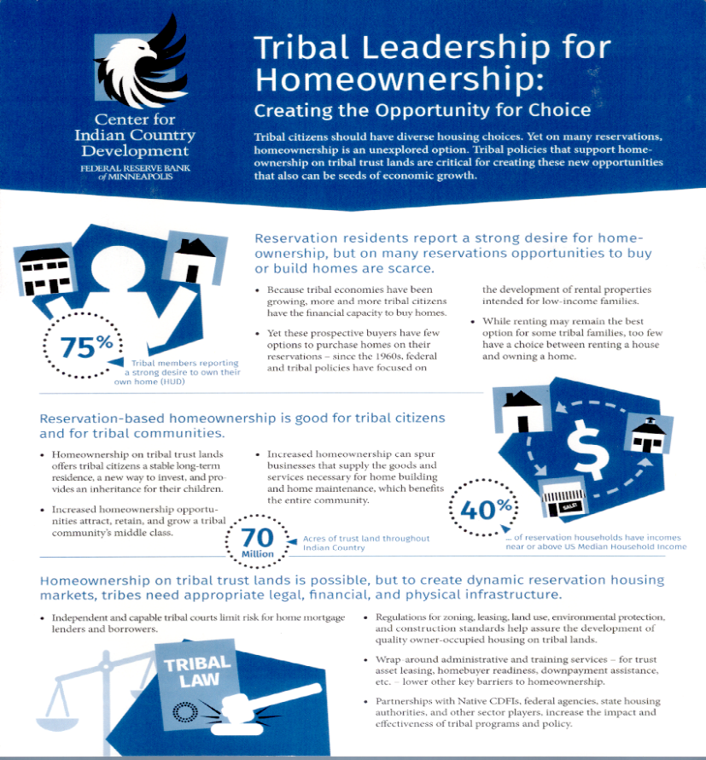
Who Are Fannie Mae’s Partners?
Banks, mortgage lenders, and small financial institutions
Native CDFIs
Tribes and TDHEs
Bureau of Indian Affairs
Native American Housing Coalitions
Government Leaders
Tribal Advocates

Slide 6
Accomplishments in 2017
Met with tribes and viewed housing first hand on reservations
Blackfeet Tribe in Montana
San Felipe Tribe in New Mexico
Gila River in Arizona
Hosted Roundtable Discussions with TDHE’s
Montana in April 2017
Arizona in June 2017
New Mexico in September 2017
Attended Conferences and Spoke on Panel Discussions
NAIHC’s Annual and Legal Conferences – June 2017 & December 2017
Great Lakes Indian Association Meeting – July 2017
Notes:
HomeReady is designed for creditworthy low to moderate income borrowers. The product was released in December of 2015 and you will see that some of the features were created to make financing available to a segment of borrowers who may not have been eligible in the past. As a result, HomeReady can help YOU grow your business and we will discuss how throughout the presentation.
HomeReady also may help lenders meet CRA lending goals.
Finally, HomeReady has significant benefits such as competitive pricing compared to standard conventional products, a cancellable mortgage insurance feature, AND a homeownership education component to help prepare buyers for long term success.

Slide 7
Learning? Challenges and How Can Fannie Mae Help
According to Research
Among AIAN households in tribal areas, there is a strong and as yet unmet demand for homeownership.
Options for mortgage financing are limited due to land complexities.
Develop Targeted and Goal-Oriented Solutions
Fannie Mae can help by doing what we do best; develop tools to expand access to homeownership
Homeownership is a key driver of economic growth and revitalization.
Expanding homeownership on trust land by reducing barriers improves reservation economies and their well-being.
Support Sustainable Homeownership
Fannie Mae has a vested interest in homeownership education; we believe HBE positions borrowers for long-term success
Notes:
HomeReady is designed for creditworthy low to moderate income borrowers. The product was released in December of 2015 and you will see that some of the features were created to make financing available to a segment of borrowers who may not have been eligible in the past. As a result, HomeReady can help YOU grow your business and we will discuss how throughout the presentation.
HomeReady also may help lenders meet CRA lending goals.
Finally, HomeReady has significant benefits such as competitive pricing compared to standard conventional products, a cancellable mortgage insurance feature, AND a homeownership education component to help prepare buyers for long term success.

Slide 8

What Is a HomeReady Mortgage?
HomeReady is an affordable low down payment mortgage product that can be used on and off tribal trust land.
It is designed for creditworthy, low- to moderate-income borrowers, with expanded eligibility for financing homes in low-income communities.
Unique land status
  Tribal Trust Land
  Allotted Trust Land
  Unrestricted Land
Underserved Markets
  Non-traditional credit
  Limited access/exposure
  to financing
  Manual underwriting
Notes:
HomeReady is designed for creditworthy low to moderate income borrowers. The product was released in December of 2015 and you will see that some of the features were created to make financing available to a segment of borrowers who may not have been eligible in the past. As a result, HomeReady can help YOU grow your business and we will discuss how throughout the presentation.
HomeReady also may help lenders meet CRA lending goals.
Finally, HomeReady has significant benefits such as competitive pricing compared to standard conventional products, a cancellable mortgage insurance feature, AND a homeownership education component to help prepare buyers for long term success.

Slide 9

Who Can Benefit from a HomeReady Mortgage?
Buyers who need flexibility with down payment
Homeowners who want to refinance to lower monthly payments
American Indian, Alaskan or Hawaiian Native (Buyers do not have to be members of a federally recognized tribe)
Borrowers who meet income eligibility as follows:
Area Type | Percentage of Area Median Income (AMI)
Low-income census tracts | No income limit
All other properties | 100%
Notes:
Now that we understand a little more about HomeReady, let’s talk about what type of customer best fits the product. They would include:
Homebuyers who may need some flexibility with down payment, income qualification or both in some cases…..
Homebuyers potentially looking to refinance in order to lower their monthly payments………..
And finally, customers who meet the income eligibility limits for the property area….
We will get to discuss HomeReady income eligibility limits in more detail……
And….. I’d like to mention that HomeReady does allow homebuyers to own other properties at the time of closing on a HomeReady mortgage!
__________________________________________________________________
There are no income limits for low-income census tracts …
For all other properties, the borrower income limit is 100% of Area Median Income (AMI)

Slide 10
Summary of HomeReady Borrower Benefits
Low Down Payment – as little as 3% down for home purchases
Fixed Interest Rates available for stability
No Upfront Guarantee Fees
Flexible Sources of Funds with no minimum contribution requirement from borrower’s own funds (1-unit properties)
Rental and Boarder Income may be considered for qualifying
Down Payment Assistance acceptable for loans with an eligible Community Seconds®
Cancellable mortgage insurance may be removed per Servicing Guide policy
Online learning through Framework’s interactive course or an approved CDFI/TDHE to explain the home buying process and the essentials of homeownership
Notes:
Let’s talk about the benefits for your customers with a HomeReady mortgage:
It allows for a low down payment, up to 97% LTV for purchases
Pricing will be competitive or better than our standard loan pricing. The LLPAs are either capped or waived altogether based on specific loan characteristics
There is no minimum contribution required from the borrower’s own funds for 1 unit properties……… And I’d like to note that it is only 3% for 2- to 4-unit properties
Rental and border income may be used to qualify a buyer.
HomeReady allows for Community seconds for down payment or closing cost assistance up to a 105% CLTV
Fannie Mae allows the use of nontraditional forms of credit for borrower qualification
Private Mortgage Insurance may be canceled once the loan reaches 80% LTV upon the customer’s request or automatically when the loan reaches 78% LTV. Let’s note that this is a feature available to other Fannie Mae conventional products.
And last but not least, Online homebuyer education is provided by our partner, Framework to educate the buyer on the process and the overall essentials of homeownership. Other Options are available to meet the homeownership education requirement, and we will get to discuss them in more detail later in the presentation.

Slide 11
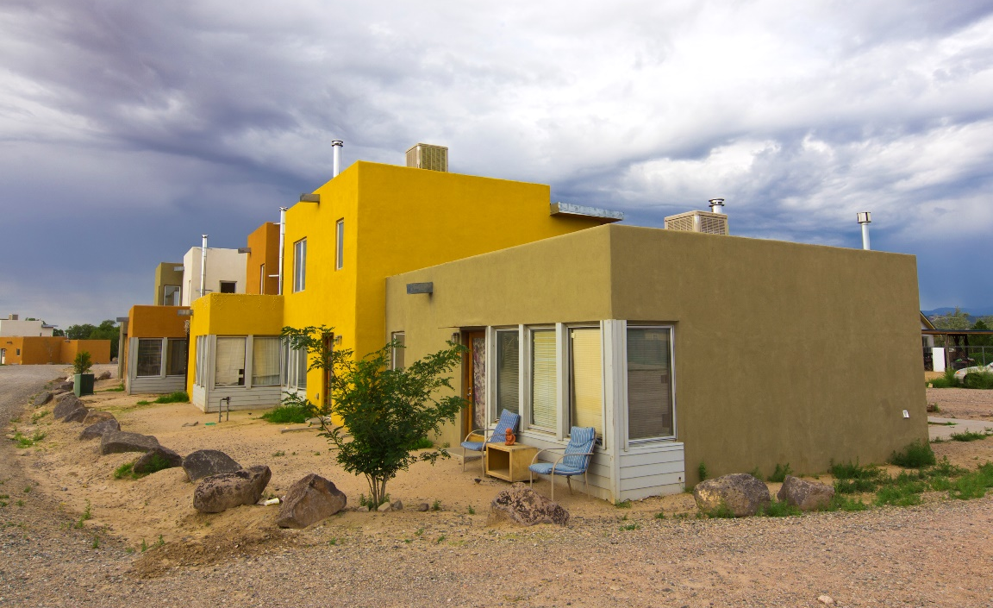
Tribe Responsibility
To participate, a tribe must have the following policies and systems in place:
Eviction, Foreclosure and Lien, and Leasing Process and Procedures
Land and Lease Approval
A system in place to ensure enforcement of the above processes
The capacity to conduct
Environmental Reviews
Infrastructure

Slide 12
Current Tribe Partners
Bay Mills Indian Community – Michigan
To Be Announced - Washington State
To Be Announced - State of Michigan
Many tribes in conversations
Notes:
HomeReady is designed for creditworthy low to moderate income borrowers. The product was released in December of 2015 and you will see that some of the features were created to make financing available to a segment of borrowers who may not have been eligible in the past. As a result, HomeReady can help YOU grow your business and we will discuss how throughout the presentation.
HomeReady also may help lenders meet CRA lending goals.
Finally, HomeReady has significant benefits such as competitive pricing compared to standard conventional products, a cancellable mortgage insurance feature, AND a homeownership education component to help prepare buyers for long term success.

Slide 13
Conduct Research Project
Fannie Mae has committed to and will publish a qualitative interview research project in 2018
This research project would fill some major gaps in what is known about Native American families’ culture
We hope to identify the challenges and opportunities that these potential homeowners face. It is also important to connect their culture and values to the value of homeownership
Lastly, this work will assist Fannie Mae in the development or enhancement of a specialized conventional mortgage product for tribal trust land
I am asking for assistance with this project?
Notes:
HomeReady is designed for creditworthy low to moderate income borrowers. The product was released in December of 2015 and you will see that some of the features were created to make financing available to a segment of borrowers who may not have been eligible in the past. As a result, HomeReady can help YOU grow your business and we will discuss how throughout the presentation.
HomeReady also may help lenders meet CRA lending goals.
Finally, HomeReady has significant benefits such as competitive pricing compared to standard conventional products, a cancellable mortgage insurance feature, AND a homeownership education component to help prepare buyers for long term success.

Slide 14
What are other goals in 2018?
Continue to meet with tribes and sign MOUs for mortgage products
Participate in coalition meetings and other tribal events
Partnered with Seven Sisters Development to bring internal training to my colleagues
Host a Roundtable Discussion – South Dakota
Support, Invest and Partner with entities to support Financial Literacy and Homeownership Education
Identify ways to support and provide capital to Native CDFIs
Educate lenders, State and Local Housing Agencies about tribal lending
Notes:
HomeReady is designed for creditworthy low to moderate income borrowers. The product was released in December of 2015 and you will see that some of the features were created to make financing available to a segment of borrowers who may not have been eligible in the past. As a result, HomeReady can help YOU grow your business and we will discuss how throughout the presentation.
HomeReady also may help lenders meet CRA lending goals.
Finally, HomeReady has significant benefits such as competitive pricing compared to standard conventional products, a cancellable mortgage insurance feature, AND a homeownership education component to help prepare buyers for long term success.

Slide 15
Questions and Contact Information
Kellie Coffey @ Fannie Mae
Telephone: 301-418-7643
Kellie_coffey@fanniemae.com
Notes:
HomeReady is designed for creditworthy low to moderate income borrowers. The product was released in December of 2015 and you will see that some of the features were created to make financing available to a segment of borrowers who may not have been eligible in the past. As a result, HomeReady can help YOU grow your business and we will discuss how throughout the presentation.
HomeReady also may help lenders meet CRA lending goals.
Finally, HomeReady has significant benefits such as competitive pricing compared to standard conventional products, a cancellable mortgage insurance feature, AND a homeownership education component to help prepare buyers for long term success.

